Slide 1
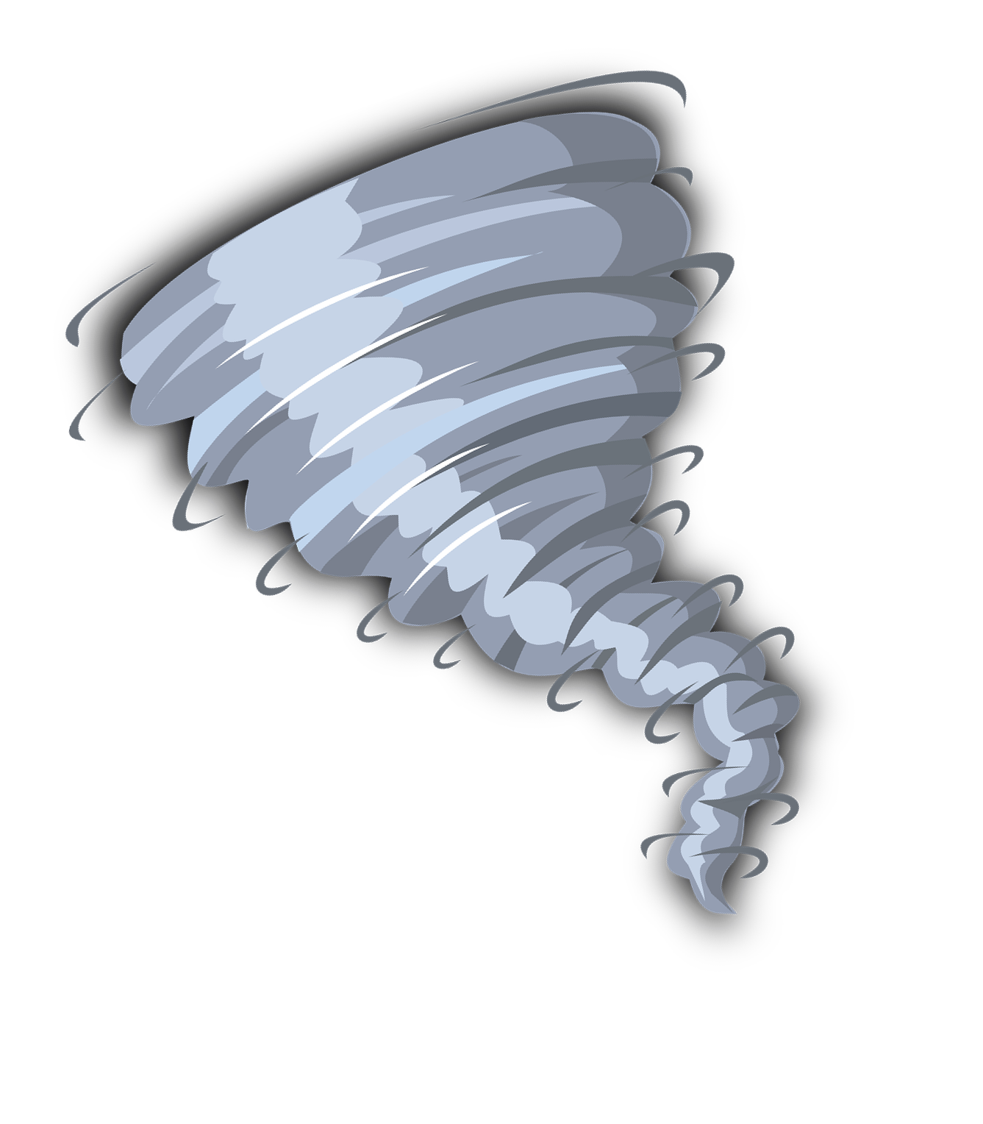
Student Booklet
Name:
Group:
Nadia Laurendeau, ESL Teacher
Sandra Laine, service national du RÉCIT, domaine des langues
Commission scolaire Marie-Victorin

Slide 2
Activity 1A - Preparation Task : Reading the Book
Take notes on what your hear and see in the book that you want to remember.
Activity 1C - Preparation Task: Watch the Movie Trailer
Take notes on what your hear and see in the movie trailer.

Slide 3
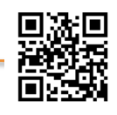
Activity 2 - Create a Timeline of the Important Events in the Tall Tale.
recit.org/ul/pfw
The children can almost smell mashed potatoes and see a giant pat of butter at
Read the story again. Take notes on the keywords that represent the important events in the tall tale they hear from their grandpa.
Grandpa tells the bedtime story.

Slide 4
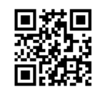
Activity 3B - Become An Expert in A Weather Phenomenon
Step 1 - In your expert group, find informations about one of these meteorological phenomena and write them in this chart. Use keywords. Step 2 - Go back into your teams to share your findings with others and take notes on the other students' findings.
recit.org/ul/pze
Meteorological phenomena | Suggestions: What does it do? What causes it? Where does it happen? Describe the damages (impact of the event on surroundings)?
Tornado
Volcano
Tsunami
Sandstorm

Slide 5
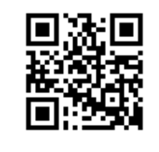
Activity 4 - Review Vocabulary About Weather Phenomena
Scatter score:
I participated in this discussion:
Always Sometimes Often Always
recit.org/ul/phf
Activity 5 - Read and answer using complete sentences.
A Wacky Weather News Report
News anchor: In this report, you will hear some wacky news about the weather.
Reporter: Here is Jeremy Cast from Tumblingdown. I am here to report on a strange phenomenon we witnessed yesterday.
Usually, it is possible to prepare for a hurricane since it is formed in the ocean before it hits the continent. This time, the sudden swirl of soccer balls surprised everyone when it started right in front of Waka Beach. The wind blew in a steady and quiet way while the water was at around 26 °C. The perfect recipe for a hurricane. We could feel the air change and soccer balls started to twirl in the air as we were swimming in the ocean. We all ran to the cabins to hide from the soccer balls that were starting to break trees, chairs, boats and piers. We were lucky to have enough time before the wind's intensity became dangerous. Suddenly, the soccer balls hurricane stopped when the rainbow wall appeared.
I hope Tumblingdowners had food reserves. All stores have been closed since that hurricane, except for the sports store that sell soccer shoes. People are using them to kick the balls out of their city. What an experience!
News anchor: Well, that is wacky news! I thought last year's pop corn flood was strange... this is even more wacky!
Show you understand.

Slide 6
Activity 5 - Read and answer using complete sentences. Show you understand.
1. Who is affected by this hurricane? _________________________________________________________________ 2. What is so strange about this phenomenon? _________________________________________________________________
3. Where does this situation happen? _________________________________________________________________
4. Do you think this could happen here? Why? _________________________________________________________________
_________________________________________________________________
5. If you could choose a name for this hurricane, what would it be? Why? _________________________________________________________________
Activity 6 - Review the different natural phenomena with Kahoot.
I participated in this discussion: Always. Often Sometimes Never

Slide 7
Activity 7 - Plan your wacky news report using keywords.
1. What? Natural disaster chosen: _____________________________
2. Why? What is wacky about it? ______________________________
3. Who? People involved: _____________________________________
4. Where? Country, city, place: ________________________________
5. When? Time, day, year: _____________________________________
6. Timeline
A. Beginning(introduction): __________________________________________________________________________
__________________________________________________________________________
B. Problem: __________________________________________________________________________ __________________________________________________________________________
C. Turning point (climax) __________________________________________________________________________ __________________________________________________________________________
D. Solution __________________________________________________________________________ __________________________________________________________________________
E. End (conclusion) __________________________________________________________________________ _________________________________________________________________________
Weather vocabulary I want to use in my text:
(wind speed/direction), temperature, precipitation, weather conditions)
_________________________________________________________________________

Slide 8
Activity 8 - Use your plan to write your wacky news report.
This is__________________ from _____________________
Checklist:
I included all the elements of a report.
I used the past tense.
I included weather vocabulary.
My text is clear.
I checked the spelling.
My ideas are original.
Image background draft.

Slide 9
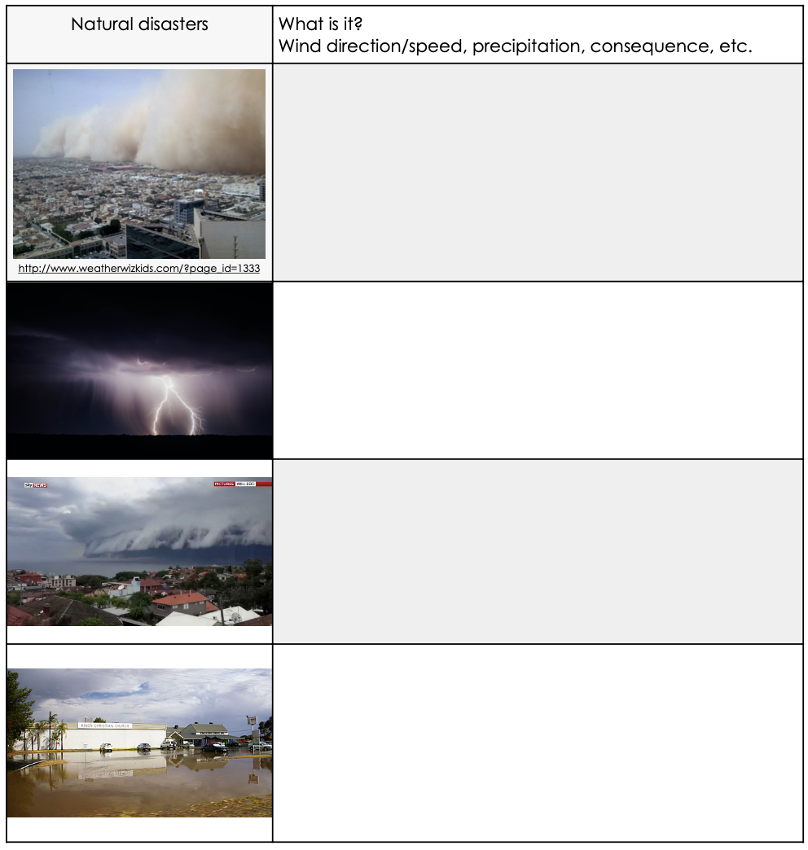
Extra Activity
Describe what you see on these images using the vocabulary in Activity 1.

