Slide 1
Going From Paper
to Digital
Elementary and Secondary
SPEAQ Convention 2020
Presentation by Sandra Laine and Nadia Laurendeau
Service national du RÉCIT, domaine des langues

Slide 2
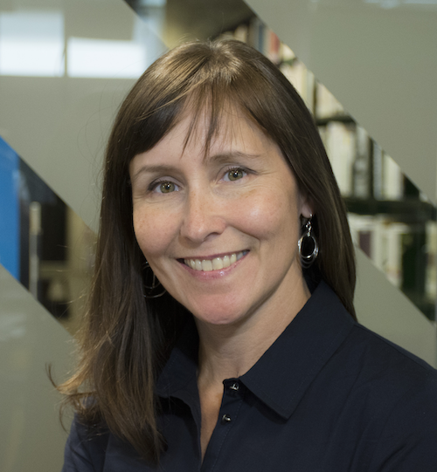
Who Are We?
Pedagogical consultants
Service national du RÉCIT, domaine des langues
Nadia Laurendeau
Sandra Laine
Martin Tremblay

Slide 3
Context and Intentions of the Development Group
Be organized and ready to teach
Have everything you need on hand
physical set-up
technological set-up
Provide resources to help teachers who have no classroom
Participants:
Julie Proteau, ESL Consultant
Alyssa Carmel, ESL Teacher
Marie-Pier Guérette-McKeown, ESL Teacher
Émeraude Grenier-Turcotte, ESL Teacher
Nathalie McDuff, ESL Teacher
Stefanie Primeau, ESL Teacher
Notes:
S
Presentation of us
Where the idea comes from : RECIT / ICT in ESL workshop given at CSDGS / idea of a PD group (need)
17-18 : CSDGS PD group, field- testing / validation
18-19 : follow-up

Slide 4
Intention
Guide teachers in being organized and ready to teach in-class and online.
Help teachers set up:
their trolley;
their digital documents and tools.
Provide resources to help teachers who need to have access to their documents from anywhere and anytime.
Notes:
S

Slide 5
Content
Class and organizational strategies
Trolley set-up
Going from paper to digital
Tools to store documents
Tools to organize content
Tools to create lessons and routines
Plan B
FAQ
Q & A
Notes:
S

Slide 6
What level do you teach?
Answer on Mentimeter
Notes:
S

Slide 7
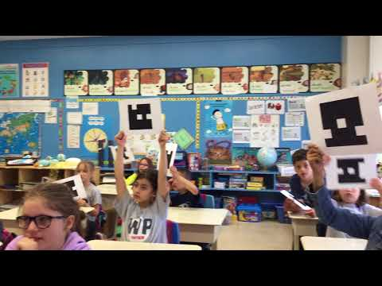
Pay attention to the strategies Kimberley uses to organize her classroom.
Notes:
S

Slide 8
What about you?
Classroom strategies:
What are the strategies used by Kimberly?
What are your strategies?
What are your challenges?
Answer on this Jamboard.
Notes:
S

Slide 9
Setting up your digital trolley
Notes:
N

Slide 10
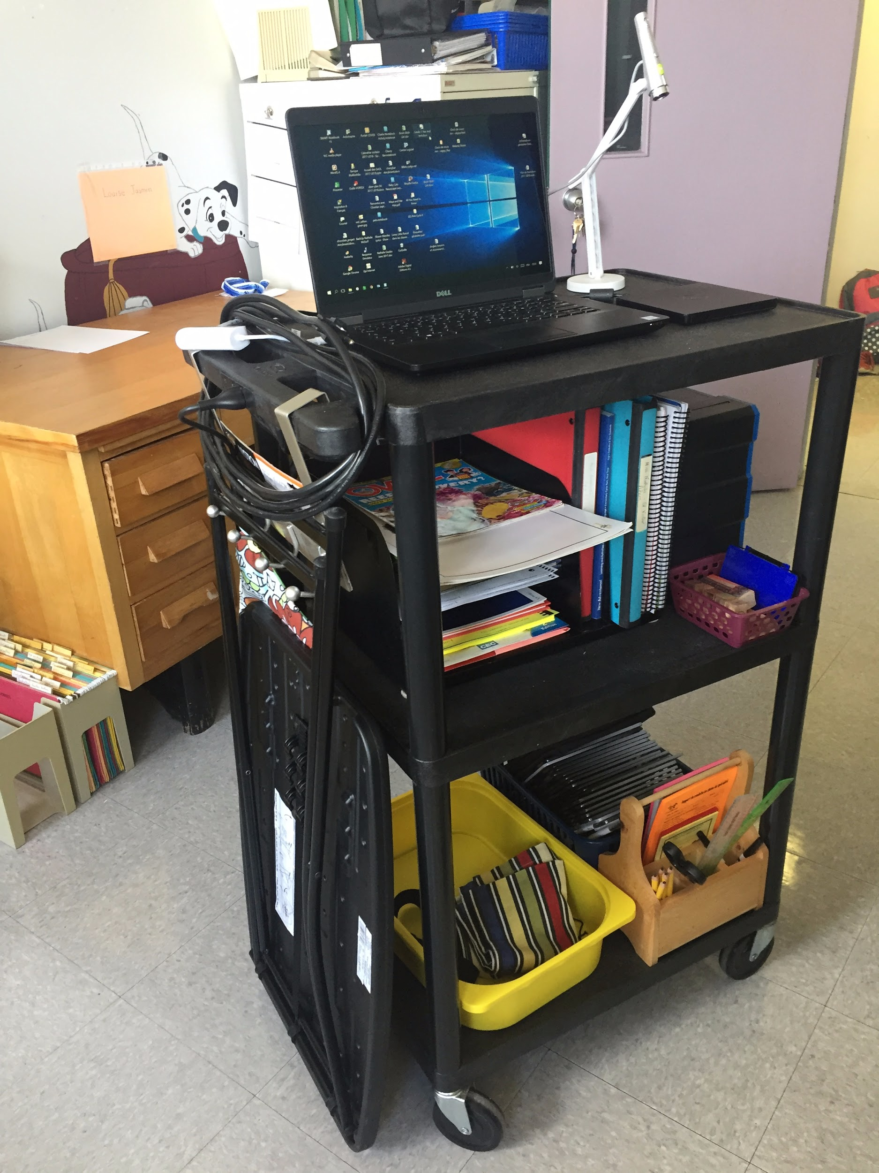
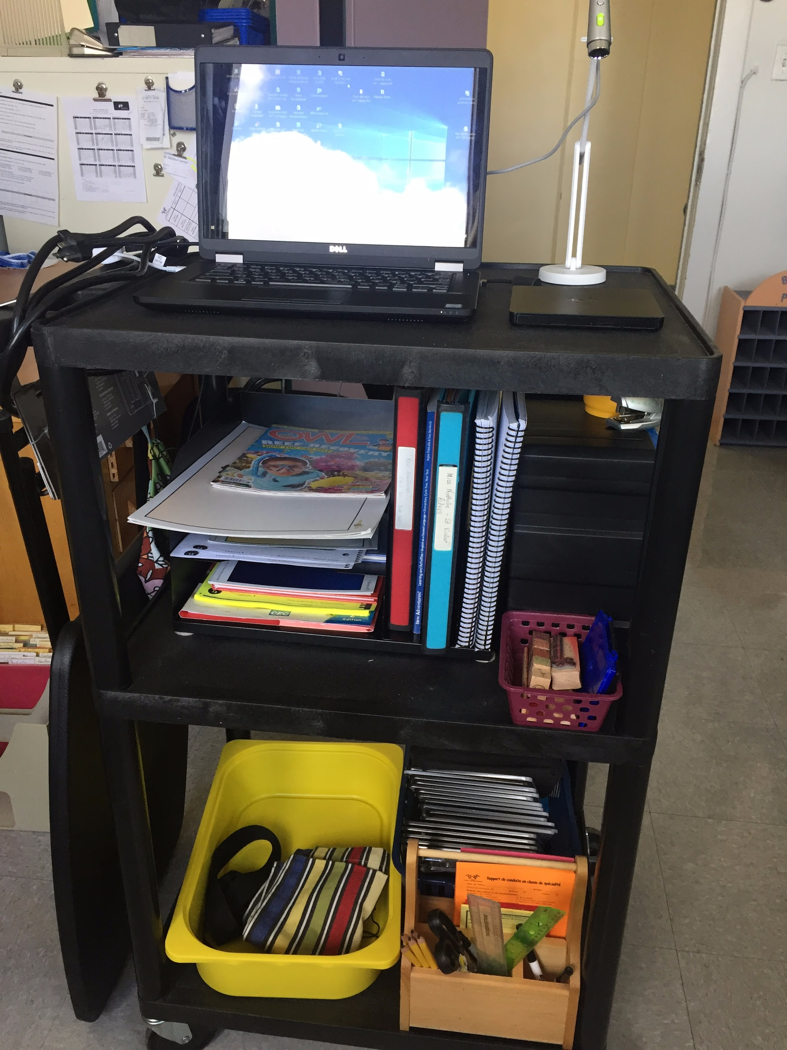
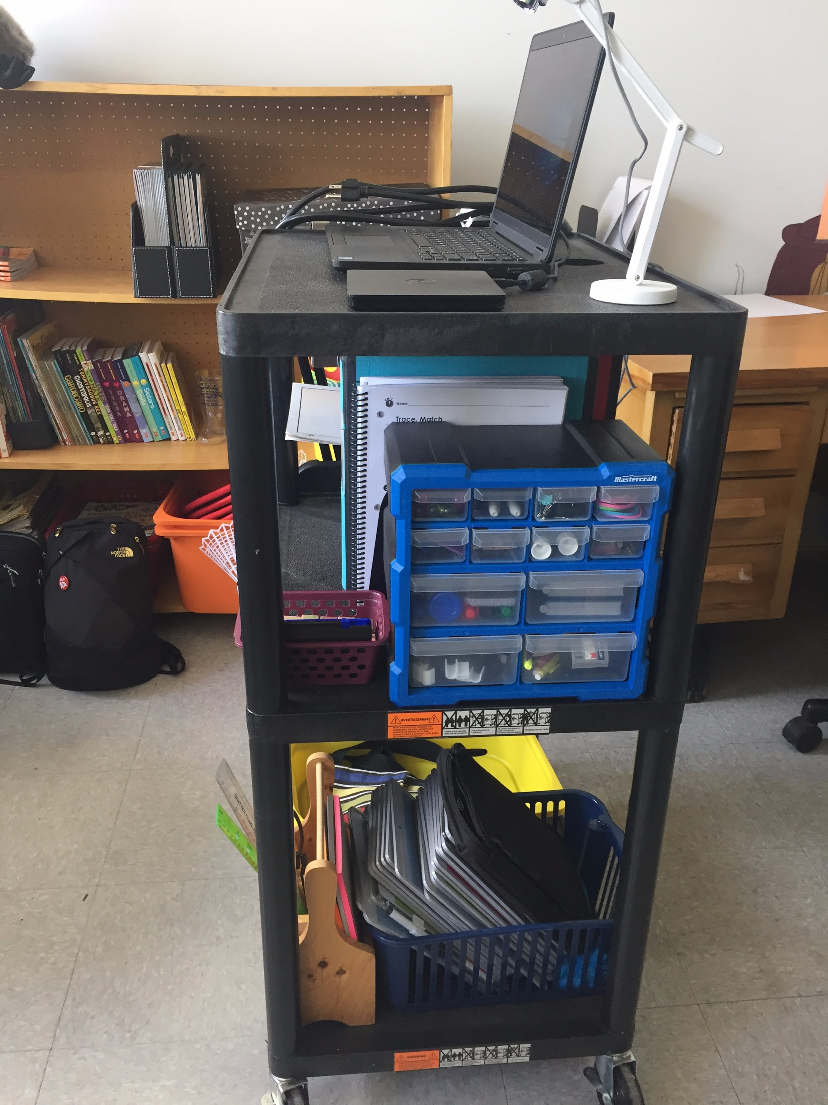
Digital Trolley Set Up
Notes:
N

Slide 11
Technological Tools
Essential:
Laptop with software adapted to the variety of interactive boards in your school.
Optional:
Wireless mouse
Wireless keyboard with touchpad
Document Camera
External DVD reader
Extension cord
Multiport
Adaptor for tablets
Notes:
N

Slide 12
Organizational Tools
Class lists
Folding table
Teacher’s agenda
Class Management Tools
Utility box with drawers for office supplies
For More Ideas
Notes:
N

Slide 13
Teaching Materials
Teaching guides
Picture cards (vocabulary and strategies)
Labelled class bins
Notes:
N

Slide 14
Digital Trolley Set Up
For more details
Notes:
N
assign students responsibilities: setting up the folding table, turning on the projector light and calibrating the board;
plug in the HDMI or VGA wire and the interactive key/wire in your computer. Set it up so that you have a clear view of the students while you are operating the computer and using the interactive board;
calibrate your IWB to make use of the interactive technology;
place the document camera on the folding table, ready-to-use for projection.

Slide 15
Going From Paper to Digital
Notes:
N

Slide 16
Suggested Tools
Store Documents | Create Lessons/Routines | Organize Content | Share Documents/information
Google Drive Office 365 | Notebook ActivInspire PowerPoint Google Slides | Padlet Wakelet Quizlet | Classroom Teams Google Site Microsoft Sway Padlet Seesaw
** Focus on Created Lessons/Routines and Organize Content
Notes:
N

Slide 17
Store Documents
Notes:
S

Slide 18
Cloud Storage
Cloud Storage Tools
A cloud storage helps you keep all your documents in one place. They are available on any device when logging into your account. The most common storage services that are used in School Service Centres are:
The advantages of using such tools are:
To prevent losing or have damaged USB keys.
To have access to everything in one place.
To have access on different devices simply by logging in.
To have an automatic backup of your files.
To easily share documents.
Notes:
S

Slide 19
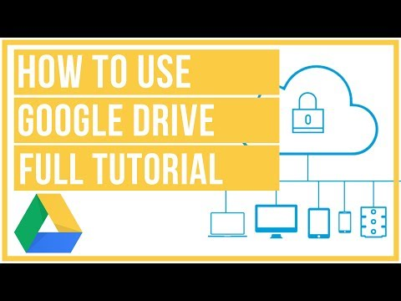
Google Drive
Google Drive allows users to store files in the cloud, synchronize files across devices, and share files. Source Wikipedia: https://en.wikipedia.org/wiki/Google_Drive
Import all your folders, files, songs, videos, etc.
Have access to all your files anywhere when you connect to your account.
Google Drive Tutorial
Notes:
S

Slide 20
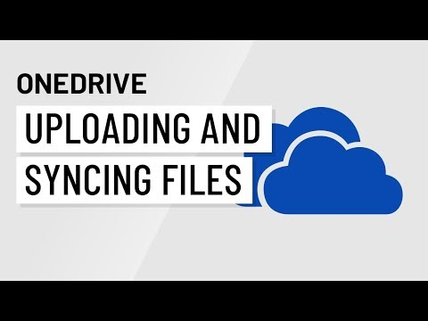
O365
OneDrive
OneDrive gives you access anywhere to all your files, seamlessly integrated with Office and pre-installed with Windows. Automatically sync your files to your desktop so you can work with files offline. Access files on Windows, Mac, or your mobile devices. (provided by your school board)
Import all your folders, files, songs, videos, etc.
Have access to all your files anywhere when you connect to your account.
Online course (FR)
OneDrive tutorial
Notes:
S
Sources: https://products.office.com/en-ca/business/online-file-storage-and-sharing

Slide 21
Organize Content

Slide 22
Wakelet
Save, organize and share content from across the web with Wakelet.
Create collections of videos, sites, documents directly from your Drive. You can use Wakelet will help you organize your content for your classes. They can be organized by topics, by grades, etc. Once set up, you can share your collections directly in your Teams or Classroom environment.
An example for Secondary
An example for Elementary
Another option: Symbaloo
Notes:
S

Slide 23
Quizlet
Using Digital Flashcards
Use Quizlet to create flashcards for your students. Organize your sets into folders for each grade. The folder can be shared with students to practise vocabulary needed for a task or a LES.
Example of flashcards for elementary grade 3 organized in a folder.
Example of flashcards for secondary organized in a folder.
Explore Quizlet
(in Modules 3 and 4)
Notes:
S

Slide 24
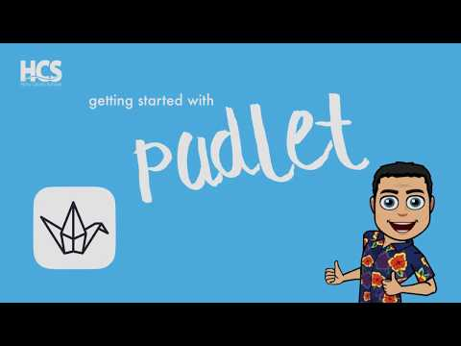
Padlet
Use Padlet to share content with parents or students.
Use it to display information for any topic:
Images
Links
Videos
Documents
etc.
Example of elementary sites organized by subjects.
Example of elementary videos organized by grade.
Notes:
S

Slide 25
Explore and discuss
In breakout rooms, you have 10 minutes to discuss the following:
Discuss how you could use the tools that were presented (Wakelet, Quizlet, Padlet).
Share a tool that you use to organize your classroom content (if you are using one).
When we come back from the breakout rooms, share one idea with the group.
Other Web Tools
Notes:
S

Slide 26
Classroom Management and Routines
Notes:
N

Slide 27
Routines
Why use routines?
Why procedures are important?
Notes:
N
Why Classroom management?
WHY ARE PROCEDURES SO IMPORTANT? v It helps create a productive learning environment v It provides students with structure and achievable goals v It helps form responsible individuals v It allows for various activities to occur during the day, with a minimum of wasted time and confusion v Students know what is expected of them v It increases on­task time and reduces classroom disruptions.
https://www.austincc.edu/teacher/files/documents/AnayansiPresentationhandout.pdf

Slide 28
Why create a routine template to support your teaching?
To be already prepared and a few plugins away from being ready to go when you enter a class or while students enter the classroom and get settled.
To organize everything in one place.
To create a routine which helps with classroom management.
To avoid wasting time in class when setting up for your lesson.
To keep traces and reuse in other moments.
Notes:
N

Slide 29
Routines
Greetings (speak or songs)
Date
Weather
Attendance
How are you?
Anything special? Birthday - Celebration of the day
Class rules or expectations
Entry and Exit tickets
Review or recap of last class - Vocab
Strategies
Today’s menu
Materials
Transitions
Brain breaks
Wrap up
Plan B or Time fillers
Current events
Discussions
Online tools we will use today
Elementary Model
Elementary Model
Secondary Model
Secondary Model
Notes:
Nadia

Slide 30
Explore and discuss
In breakout rooms, you have 10 minutes to discuss the following:
Discuss how would adapt the routine document to your needs.
Share other information that could be added.
When we come back from the breakout rooms, share one idea with the group.
Notes:
N

Slide 31
Share Content
Notes:
N

Slide 32
Share Content with a Learning Management System
Google Classroom
Teams
Online course for Teams
Notes:
S

Slide 33
Share Content with Online Tools
Google site
Microsoft Sway
Padlet
Seesaw
Explore Padlet (in Modules 3 and 4)
Notes:
s

Slide 34
Plan B
Notes:
N

Slide 35
What If?
Descriptions and examples
Picture dictation
Find the differences (online)
Would you rather
The famous 5 Minutes to Go
Board games
Just-a-minute!
Buzz
Other Web Tools
Notes:
N
Make paper copies and keep them in case there is no internet available.
Or use these tools online when you need a short activity at the end of a lesson.

Slide 36
FAQ
Notes:
N

Slide 37
Where Can I Find...?
Where do I get copyright free pictures?
Where do I get ESL songs?
Where do I get functional language posters?
Where do I get resources for ESL teachers?
Who do I contact if I need help?
Where do I get free online books?
Guide
Notes:
N

Slide 38
Which resources will help you start going from paper to digital?
Access menti.com
Notes:
S

Slide 39
What’s next?
We would like your input regarding our next actions.
Complete this form.

Slide 40
Other resources and ideas from the chat during the workshop
Distance teaching resources on a Genial.ly
Is there a way to share only one slide at a time in a Google Slides presentation? Check Adam Davis’ answer on this page. In this case, the slides are separated from the original document.
This short tutorial explains what Sandra mentioned about the unique URL to point to one of the slides in a document. All the other slides are still accessible.
Plickers is a tool for teachers without technology in class for their students or online if each student has their own cards. (never tried but I would be curious to see if it does through the screen
Facebook: www.facebook.com/domainelangues
LES: Wacky Weather News Report
Edpuzzle is another great tool to work with videos

Slide 41
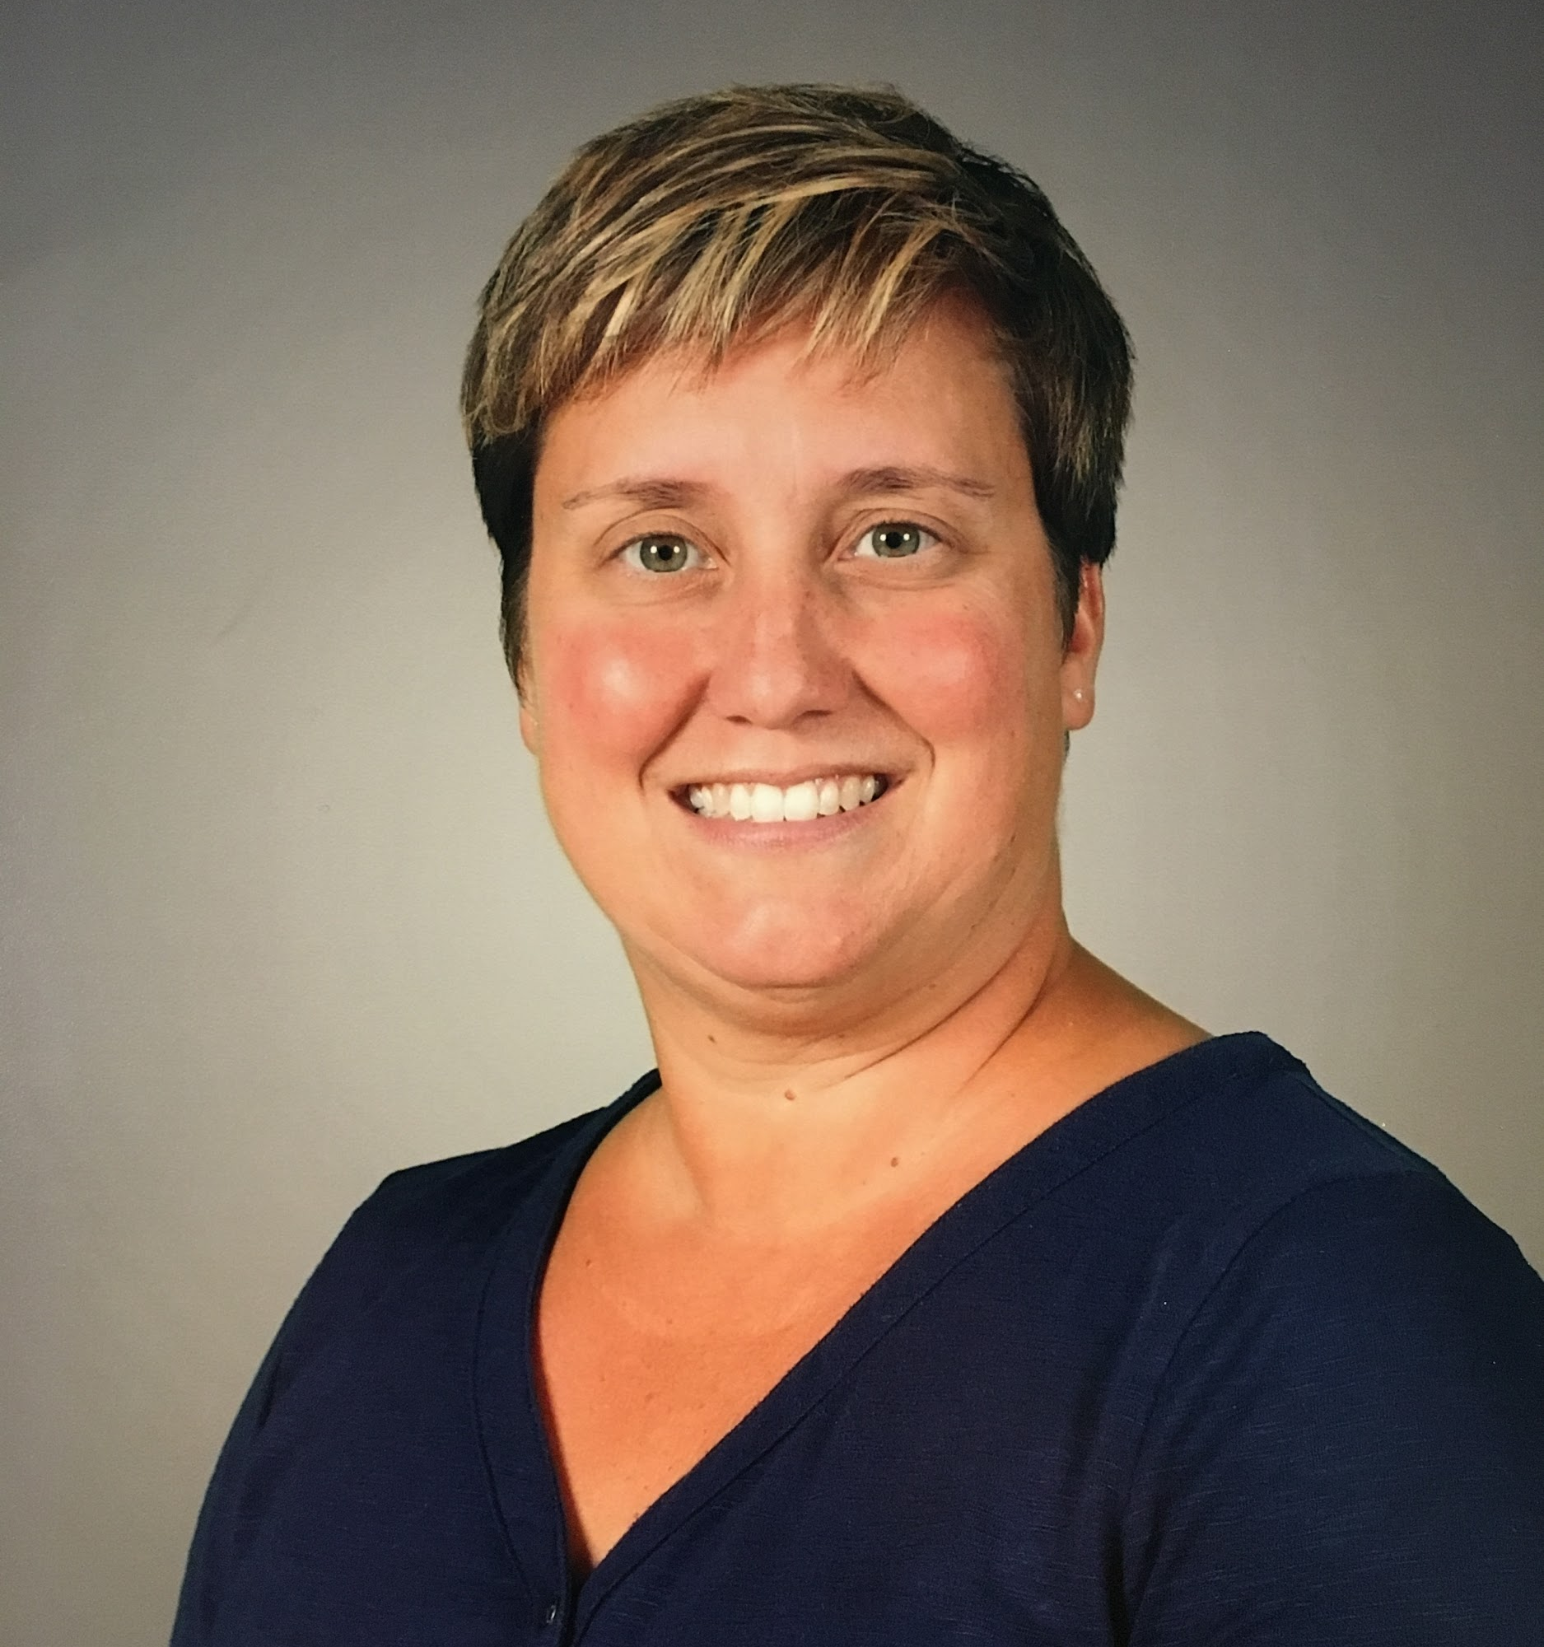
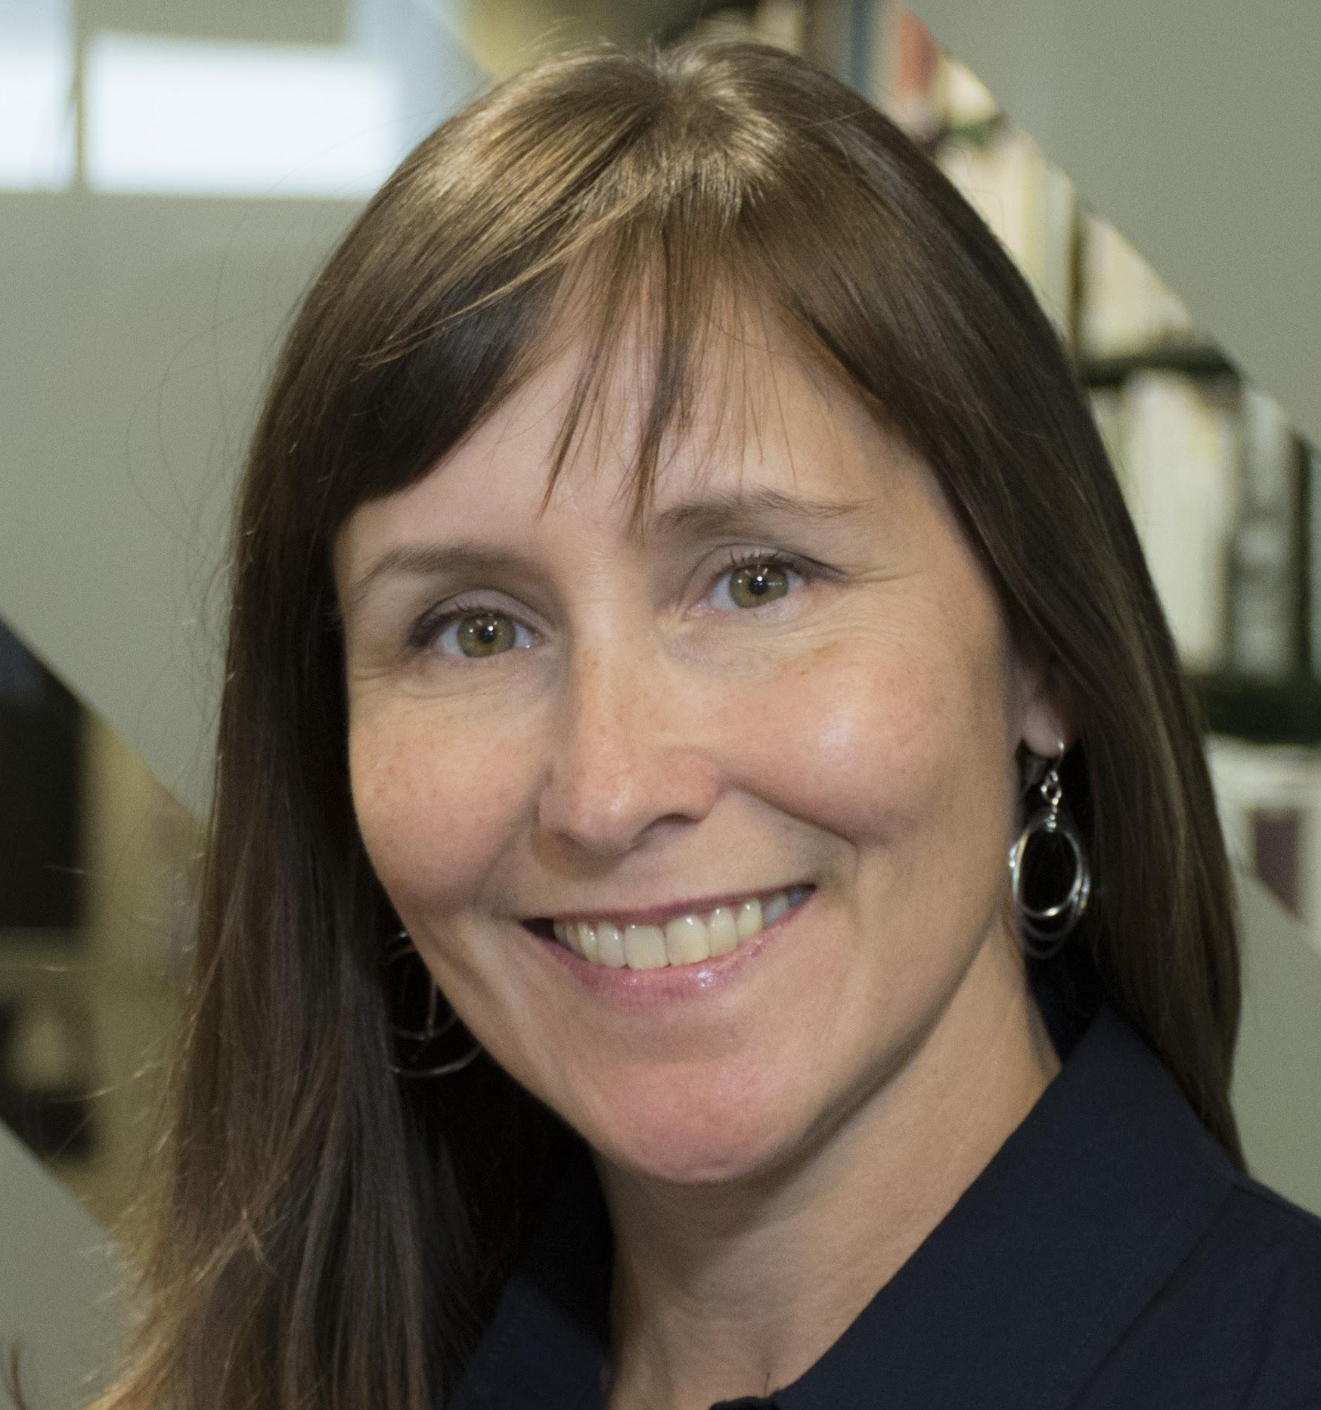
Contact Us
Site: www.domainelangues.qc.ca/en
Facebook: www.facebook.com/domainelangues
Nadia Laurendeau
nadia_laurendeau@csmv.qc.ca Twitter: @nadialo
Sandra Laine
sandra_laine@csmv.qc.ca Twitter: @sandralaine
Martin Tremblay
martin_tremblay@csmv.qc.ca
Twitter: @Mrecit
Notes:
S

