Slide 1

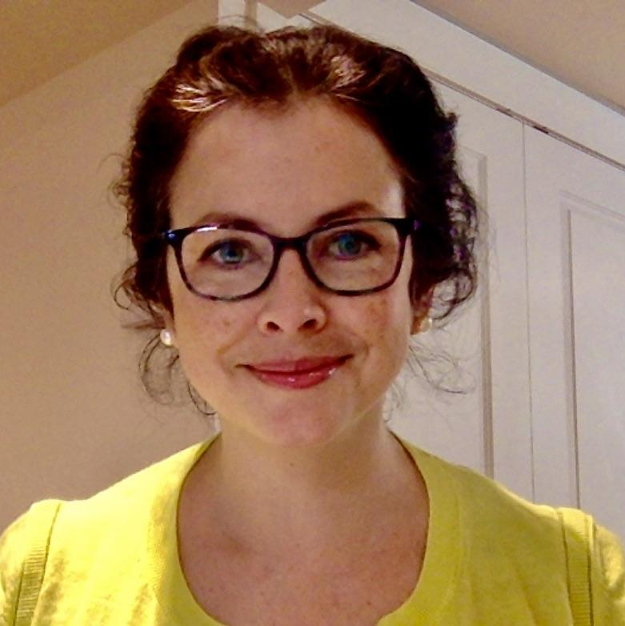
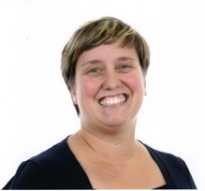






Make it a Habit! Reduce, Reuse, Recycle
Creating a media message to give ideas of good habits
that will help the planet
Make it a
Habit!
Reduce
Reuse
Recycle
ESL Teacher
CSSMV
Elementary
4 and 5
Elisabeth Sommerville
Pedagogical Intention
Students will learn about good habits to be more environmentally friendly by recycling correctly, reducing waste and reusing objects.
Mix and Match
For each step, a choice of activities integrating technologies are suggested and teachers can choose which one to use with their students according to their needs and technology available.
Make a copy of these documents and adapt them:
Student Booklet
Slide - PPT
Teacher Guidance
Slide - PPT
Other collaborators
Cindy Stern
ESL Consultant CSSMV
C1
C2
The good habit ideas are presented with;
Book Creator ,
PosterMyWall or
Scratch
Individual and team tasks
Interact orally in English
Reinvest understanding of oral and written texts
Technology
Nadia Laurendeau
Service national du RÉCIT, domaine des langues

Slide 2









Mix and Match
Select the options that best suits your pedagogical intentions and
digital tools available.
Activate Prior Knowledge
Activity 1: Help the planet. Watch this video: A Whale's Tale
Activity 2: What is this symbol?
Click on the logos and links to access the activities
Activity 3: Learn Vocabulary
3 options to introduce students to vocabulary related to Reducing, Reusing and Recycling vocabulary
Slide/Powerpoint
Quizlet
Jamboard
Option A | Bingo
Option B | Flashcards
Option C | Match the definitions
Activity 4: Habits and Waste Management
In stations, students discuss habits and waste management.
Station 1
Station 2
Station 3
Station 4
Sort objects
Discuss good habits
Discuss trash and recycling
Organize
waste
After working in the stations, verify general understanding before moving onto the next task with Quizziz and/or asking them to illustrate what they’ve learned on paper or digitally.
Activity 5: Prepare for the final task
Watch the video How to Take Care of the Environment (suggested until 3:18)
Brainstorm on habits we can develop to help the environment. Digipad brainstorm model
Activity 6: Give ideas to develop good habits to help the planet
Students have a choice between 3 options to create a media message to encourage others to develop a habit to manage waste to help the planet.
Option A | Option B | Option C
Write a book about what others can do to develop good habits to help the planet. Book Creator | Create a poster about what people can do to change their habits. PosterMyWall or Digicard | Create an animated dialogue about what people can do to help the planet. Scratch

