Slide 1


Make it a Habit!
Reduce
Reuse
Recycle
Grades 4 and 5
Teacher Guidance
Elisabeth Sommerville, ESL Teacher, CSS Marie-Victorin
in collaboration with Cindy Stern, ESL Consultant CSSMV and
Nadia Laurendeau, Pedagogical Consultant, Service national du RÉCIT, domaine des langues

Slide 2
How to use this document
This document is meant for teachers to use on the interactive whiteboard or in their Learning Management System (Google Classroom, Microsoft or others) to make all the steps of this project visible to students.
The idea of this project was to design short reinvestment tasks. Teachers in this project quickly realized that to create a good reinvestment task, it is important to follow the steps and therefore, it takes time.
Planning for your needs
You will find important information and links in the speaker notes of each slide (remember to view the speaker notes). Click on logos or website addresses for direct access to the documents to modify. At times, you may need to create an account or make a copy of the various online tools.
The mix and match idea lets you plan according to your students’ levels, the technology available and the digital tools they already know.
You can add, delete, and modify every element to adapt to your students’ needs and the technology available. The student booklet (SB) could be used in a digital format or printed.
Depending on the level of your students or their prior knowledge, you may have to prepare them with extra activities.
Click on the links or logos to access the documents or websites.

Slide 3
Intention
Students will learn how to make a more environmentally friendly classroom and give ideas to develop habits to recycle correctly, reduce waste and reuse objects in their daily life.
Learn more!

Slide 4
Let’s Prepare!

Slide 5
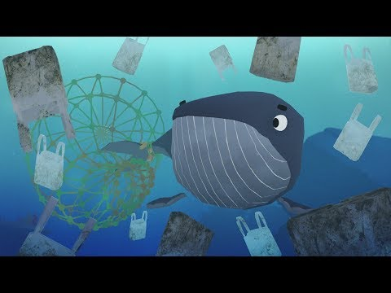
Activity 1 - What is happening to our planet?
Discuss the video.
Write down some words to remember in your student booklet.
What are other words for trash?
Notes:
Access the video integrated in Edpuzzle. Questions pop up when they are relevant to the theme.
The discussion can be done as a class or in partners, depending on your students’ level.
Student booklet p.2

Slide 6

Activity 2 - What is this symbol?
Notes:
Student booklet p. 3.

Slide 7
The Recycling Process
Activity 2
eas
Each arrow represents the different steps of the recycling process.
1. Collect recyclable materials like plastic bottles and aluminum cans.
2. Process the material and make them into new ones.
3. Buy items made by the recycled material.
1
2
3
Notes:
Student booklet p. 3.

Slide 8
The 3Rs of Waste Management
Recycle
Reduce
Reuse
The process done to paper, plastic, metal or glass to make a new object.
To reuse is to find a different way to use the material to not pollute the earth with our trash.
We reduce our consumption to lower the amount of pollution we make.
How do you apply the 3Rs in your classroom?
Activity 2
Notes:
Student booklet p. 3. Extra resource
It’s also possible to discuss the idea of refusing an object or an action. It would become the 4th R (Refuse, Recycle, Reduce, Reuse)

Slide 9
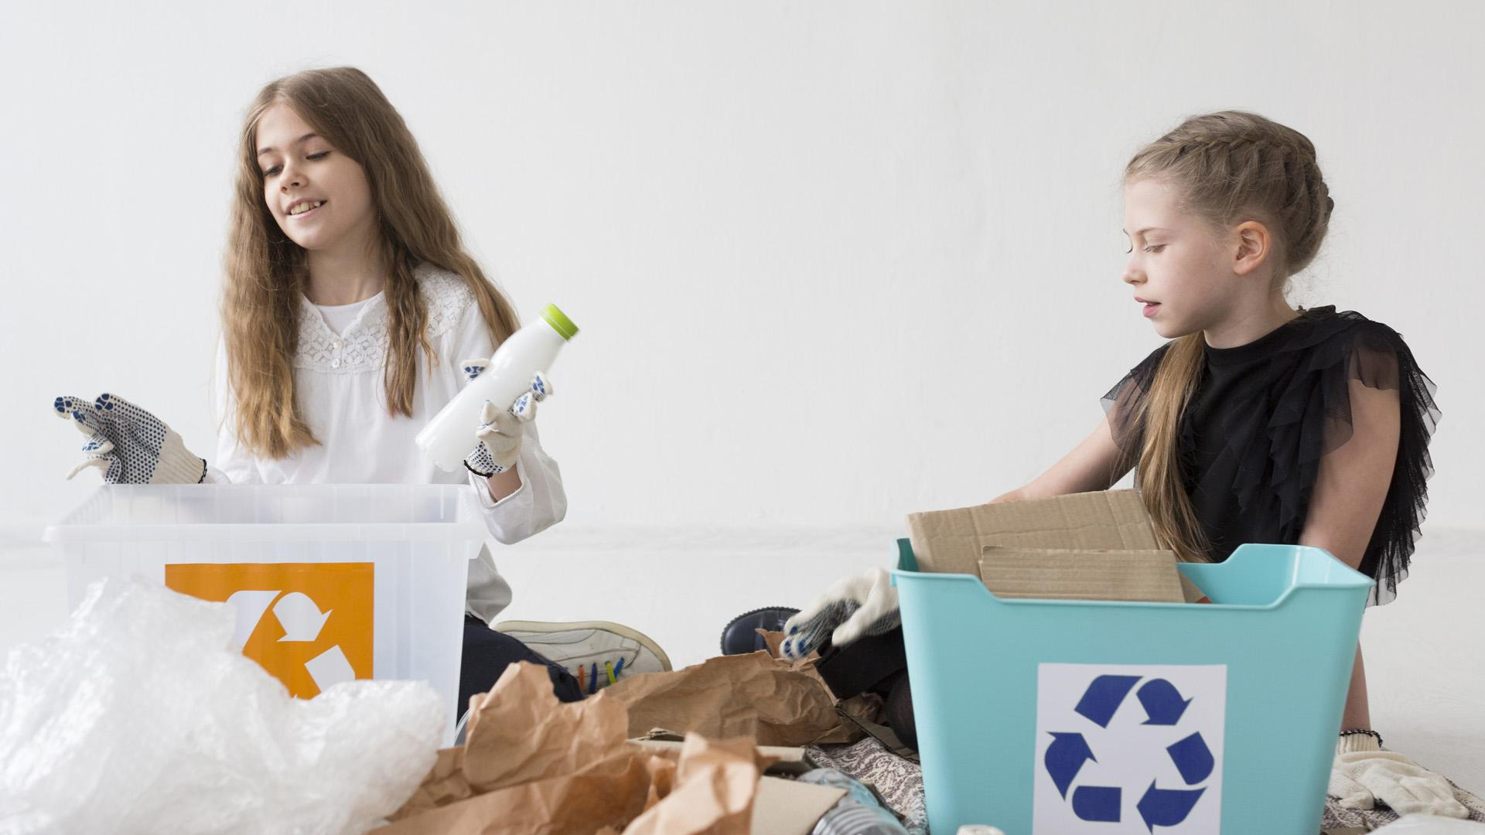
The world produces about 300 million tons of plastic waste each year.
Only 9% of the plastic waste generated is recycled.
Did you know?
Notes:
General information

Slide 10

Now, your turn:
Questions to ask yourself before you throw something out:
Can I recycle this?
Can I reuse it in any way?
How can I help reduce pollution?
Notes:
This is to activate prior knowledge.

Slide 11





Options to learn vocabulary
Activity 3
Option A
Bingo
Option B
Flashcards
Option C
Match the definitions
Notes:
Teacher: Select the option(s) you would like to use with your students and modify the presentation accordingly.
The links are on the slides of each activity.
Share the corresponding page in the Student Booklet (or leave it in the document when you give it to your students).

Slide 12
Learn vocabulary
Activity 3
Option A
Bingo
Directions:
With a partner, match the words with the images on the page.
Take a Bingo card and place your objects.
Listen to the person calling the objects.
Place a chip on the word you hear.
Say “Bingo!” when you have 3 in a row.
Notes:
Make a copy of this document: Google Doc or PPT
This digital Bingo game can be adapted with the words you wish to use with your students.
The document has a slide for each student. You can also share it individually with them or print them.
Give them time to create their Bingo card. Use the slide 2 to call out the words and remember which ones came out.
Students take a round chip and place it on the object on their page.
If you wish, this could be done is smaller teams where a student calls out the words to his classmates.
Another option:
You can also use the Bingo Baker free online game. There is no need to pay for the tool. Read the help page.
https://bingobaker.com/view/6044516

Slide 13
Learn vocabulary
Activity 3
Option B
Flashcards
Directions:
Use a computer or a tablet with your partner. Join Quizlet by using the code your teacher gives you: __________
Play with the Flashcards to learn the vocabulary words.
Play the Match game to learn the vocabulary words.
When ready, write the correct words next to the images in the chart below.
Notes:
Teacher notes: Make a copy of this flashcard set in your account to adapt it to your students’ needs or use this one with the words on page 5 of the Student Booklet.
Make sure you add the link to the SB if you use the digital version or share it with your students by email or Google Classroom or TEAMS.

Slide 14
Learn vocabulary
Activity 3
Option C
Match
definitions
Directions:
With your partner, access the activity in Jamboard.
Discuss possible matches of words and definitions.
Use the site or app Wordhippo.com. It is a dictionary you can use as a resource.
When the Jamboard answers are verified, write the correct word with the definition in the chart in your Student Booklet.
Notes:
Words are different than in Options A and B. Activity 3 - Learn vocabulary (make a copy) . Then, share the link with your students.
Make a copy of this document and adapt it to your needs if necessary.

Slide 15
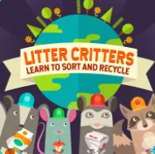

Discuss habits and
waste management
Activity 4
Station 1
Sort objects
Station 2
Sort
Good Habits
Station 3
Discuss
trash vs recycling
Station 4
What does it help?
Notes:
Select the stations you would like to use with your students and modify the presentation accordingly.
The links to the activities are on the slides you selected.
If students don’t know about the digital tool, depending on their level of ease with technology, you may need to explain the tool before sending them in stations.
Each station is approximately 10 -15 minutes.
Grouping students in teams will help the organization of the stations since it will mean less devices to manage. It will also encourage students to interact with each other in order to complete the tasks. They will help each other understand the texts.

Slide 16
Discuss habits and
waste management
Activity 4
Station 1
Sort objects
Directions
1. With your partner, access the “Learn to sort and recycle game” online.
2. Select EASY and click play to read the information about recycling and answer the questions.
3. As you play, discuss if each article can be recycled.
4. Continue the game for each part: recycle, compost, electronic waste, and landfill waste.
Notes:
https://www.abcya.com/games/recycling_game
This is an online game. There are 2 levels; easy and hard. There are 4 parts to the game: recycle, compost, electronic waste, and landfill waste. At the beginning of each part, there is a short text explaining the different types of waste.

Slide 17

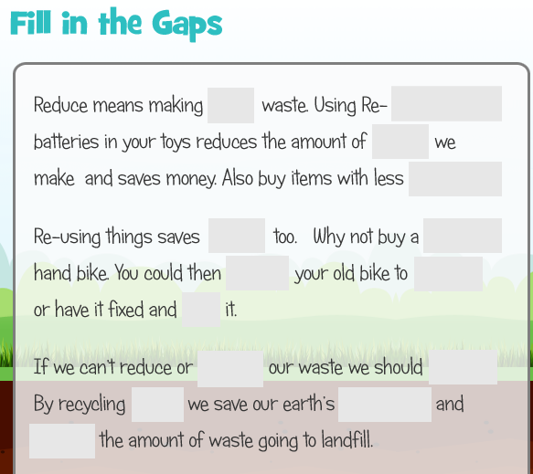
Discuss habits and
waste management
Activity 4
First part - Directions
1. With your partner, access the Jamboard activity.
2. Discuss if each action helps trees, water or animals and place the sticky notes in the correct space.
3. Discuss if you could develop each habit and how.
4. When all the habits are placed, answer the questions in your student booklet.
Station 2
Discuss
good habits
Second part - Directions
1. With your partner, access the Fill in the Gaps.
2. Read and find the word on the right to complete the text.
3. Recopy the correct words in your student booklet and answer the questions.
Notes:
Note for the teacher: Make a copy of this document and adapt it to your needs. Add the link to their SB if they are using an online version.
You could copy the first board into the number of teams or students and assign them to one.
Jamboard activity link (make a copy)
The fill in the gap gives other ideas of good habits.

Slide 18
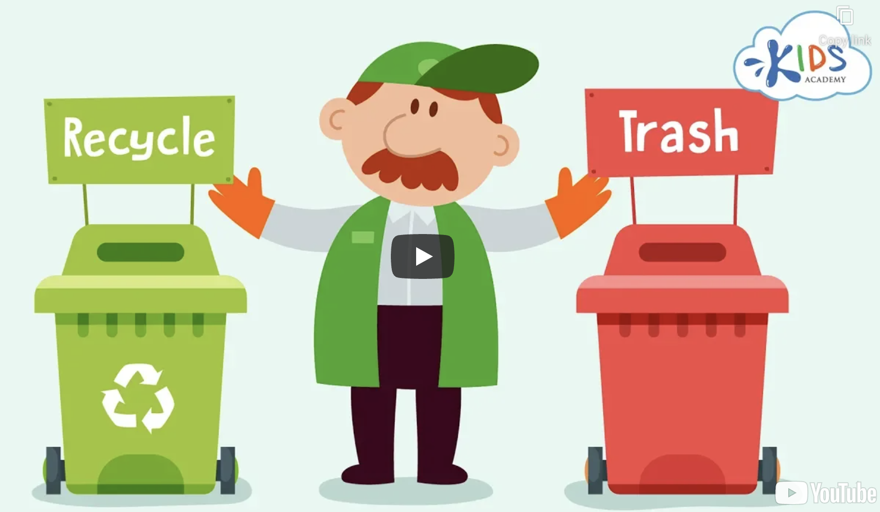
Discuss habits and
waste management
Activity 4
Station 3
Discuss trash and recycling
Directions:
In pairs, watch the interactive video Recycling on Edpuzzle.
When the video stops, read the question and discuss with your partner before choosing the correct answer. You can pause or rewatch the video any time to think or discuss.
Write down some of the information by answering in your Student Booklet.
Notes:
Access the interactive video.
Log in to make a copy of the Edpuzzle quiz and adapt it to your students’ needs, if needed.
Students are invited to discuss the possible answers when the video stops.

Slide 19
Discuss habits and
waste management
Activity 4
Station 4
Organize
waste
Directions:
Access the digital document.
With your partner, pick an object and say it out loud.
Discuss if it goes in the recycling bin or the trash bin.
Discuss if it helps or hurts water (W), animals (A) or trees (T).
When all the objects are placed on the board, write them on this page under the correct category.
Think about objects in your home and discuss where they should go with your partner. Add them to this chart.
Notes:
Make a copy of this document in your Google Drive
Make a copy of this document in your Office Drive
Teacher: Prepare a slide for each team/pair of students so they can discuss their answer and then write them in their student booklet.
It’s also possible to share it in their LMS (Google classroom or Microsoft TEAMS or OneNote).
Once the sorting activity is completed, students can make a “collage” of what they have understood of the previous page. You can let them use PicParty on iPads, use a different slide in PPT or GSlide or simply use the student booklet page (paper or digital)

Slide 20
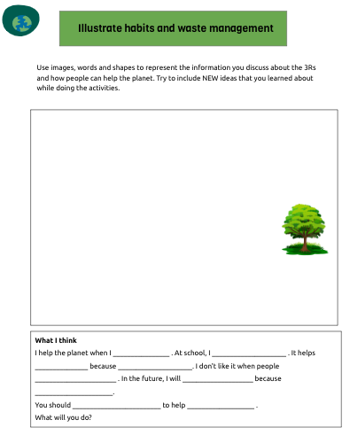
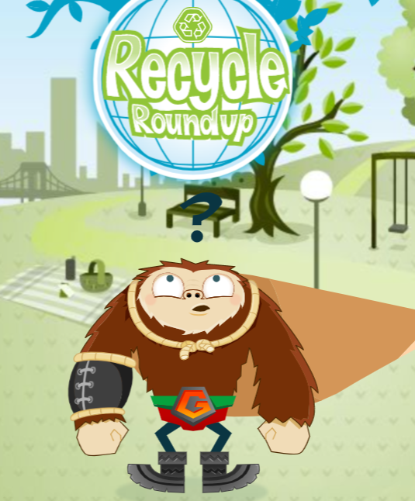
Let’s see what you know
Activity 4: optional
Show what you learned in the stations.
Illustrate habits and waste management.
Complete the short paragraph.
Notes:
Use this as an extra activity or to give them a chance to show what they have learned. You can also give them the link to the online game to play with the recycling game.

Slide 21
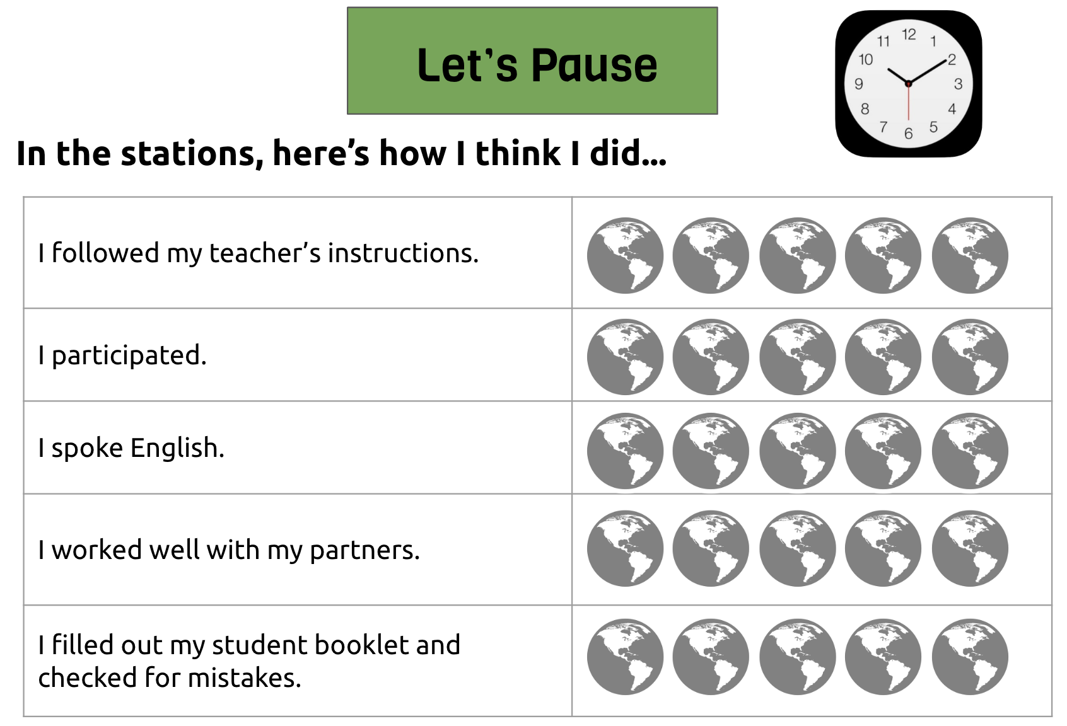
Notes:
Give time to students to reflect on their work in the stations.

Slide 22
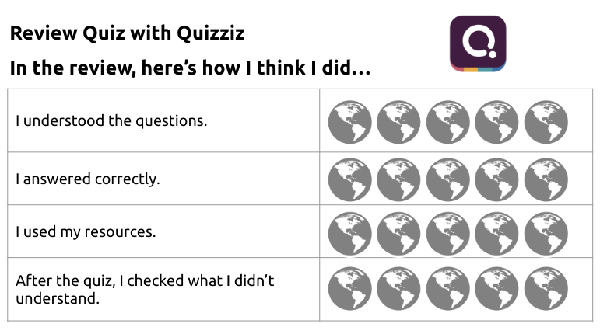
Notes:
Give students time to reflect on their work in the stations.

Slide 23
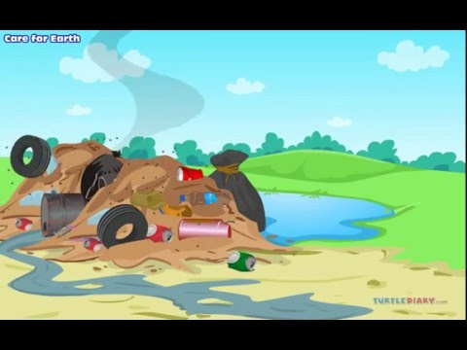
Prepare for the final task
Activity 5
Write down habits in your student booklet.
Notes:
Suggested until 3:18 min.

Slide 24

Prepare for the final task
Brainstorm on habits we can develop to help the environment.
Activity 5
Notes:
Make a copy of the brainstorm on La digitale or use any other digital tool to keep traces of what students suggest. Model: https://digipad.app/p/188132/60709940dd28
Other collaborative walls: Padlet, Mentimeter, Jamboard.

Slide 25
Final task
Give ideas to develop good habits to help the planet
Activity 6
Notes:
See next page.

Slide 26
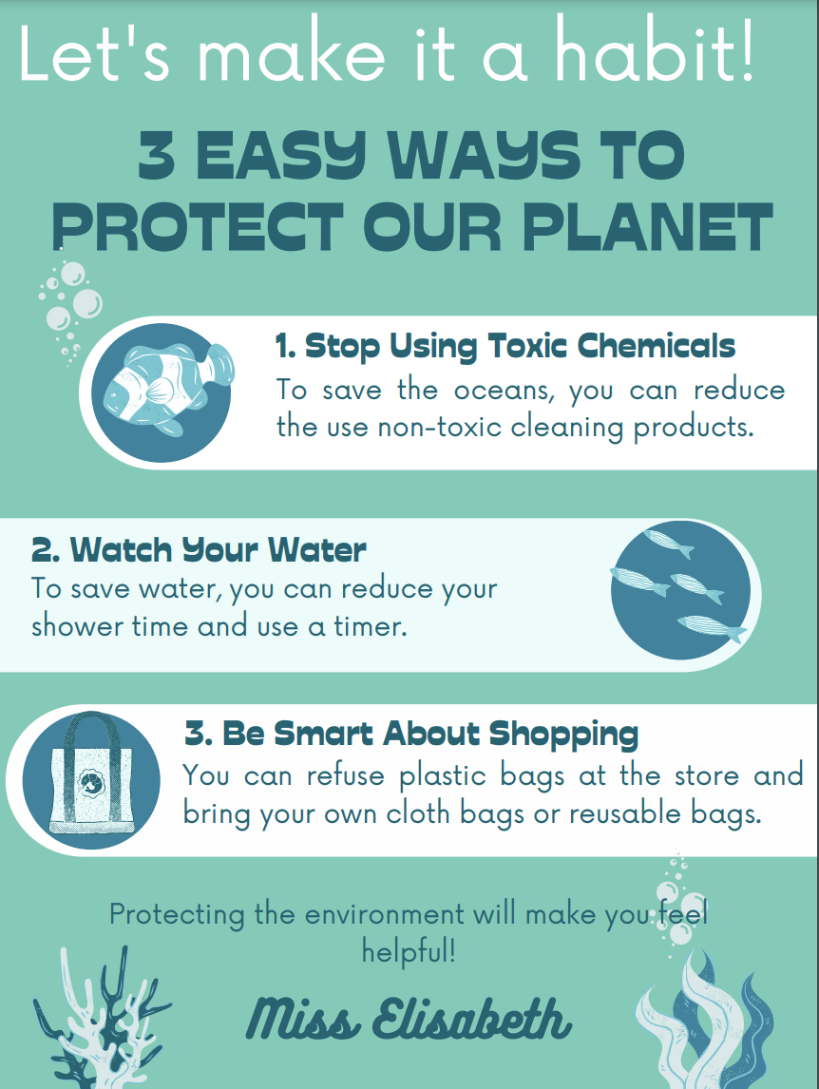
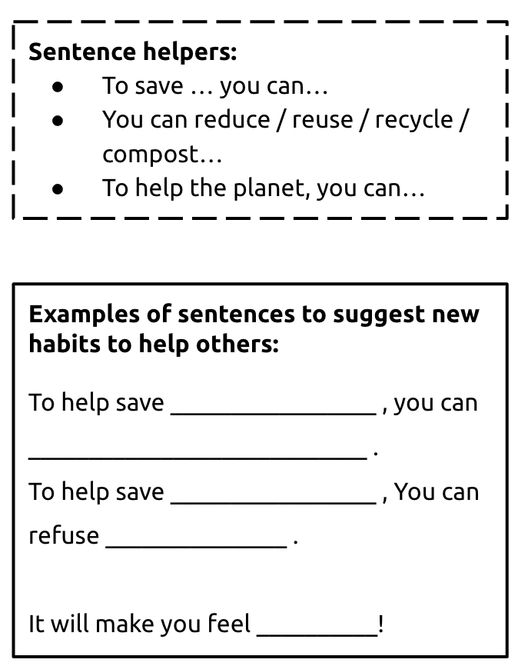
Text structure
Notes:
Click on the Poster image to view it larger.
These are the models that you could provide to students. However, depending on your students’ level, you may choose to adapt them.

Slide 27




Options for the Final Task
Activity 6
Option A
Digital book
Option B
Digital poster
Option C
Animated dialogue
Book Creator
PosterMyWall
Digicard
Scratch
Notes:
Select the option you would like to use with your students and modify the presentation accordingly.
You could create a model with one of the suggestions. There are tutorials in the online course on Campus RÉCIT.

Slide 28
Extra activity
Access this slide template with an extra game about recycling. Download a copy for yourself in GDoc or Word and play with your students.
World Environment Games and Activities

Slide 29
Thanks
Every small action counts. Let’s protect the environment together!
Please keep this slide for attribution.

