Slide 1



Once Upon a Time
Teacher presentation
Writing and producing a narrative story using an animated tool
Created by Joey Simard-Bolduc from CSS Portneuf
in collaboration with the Service national du RÉCIT, domaine des langues
Notes:
Use with the Overview document
<a href="https://storyset.com/education">Education illustrations by Storyset</a>
The thank you slide must be kept in order to follow Slidesgo guidelines.

Slide 2
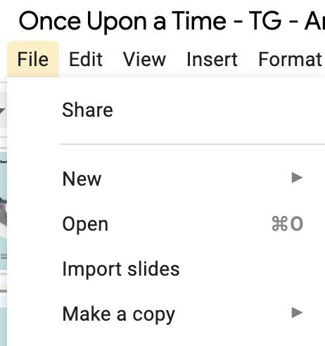
Comment for teachers
Make a copy of this document and adapt it to your needs.
Please keep the information about authors and template.

Slide 3
Overview
Through the exploration of fairy tales, you will learn the steps of a narrative story and create an animated story.
Notes:
Resource: https://fairytale.fandom.com/wiki/Fairytale_Wiki

Slide 4
You will…
1
2
3
write and produce an animated story.
understand the characteristics of a fairy tale.
understand the characteristics of a narrative story.

Slide 5

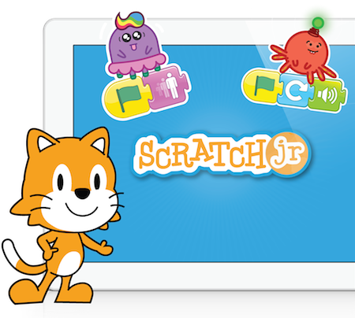
You will use…
Toontastic 3D app (no longer available)
Scratch Jr
Notes:
Toontastic 3D is not available on iPads if it’s not already uploaded. Available on Android tablets.
Other animation tools: Powtoon

Slide 6

Famous Characters
How well do you know your classic stories?
Complete the quiz.
Discuss which characters are from fairy tales. Why?
Notes:
Copy and adapt this quiz to your needs. https://quizizz.com/admin/quiz/60d5eeca32cdbc001c559ba6.

Slide 7


Re-discover a Fairy Tale
The Little Red Riding Hood
Listen and read the story here

Slide 8

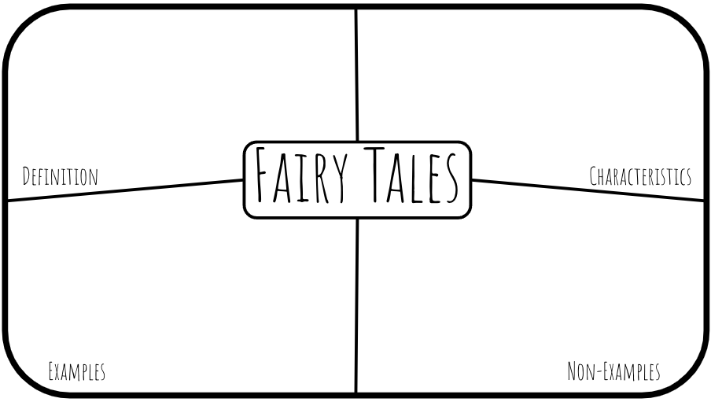
Characteristics of Fairy Tales
A
B
C
In small teams, complete this graphic organizer.
Share with another team and add information.
Discuss as a group.
Notes:
Make a copy for your teams.

Slide 9






Narrative Steps
Setup
Conflict
Challenges
Climax
Resolution
Analyze these steps with the Little Red Riding Hood story.
Student handout
Notes:
This could be done in small groups or as a class. The handout could be shared as a copy to each student.
Check understanding with this activity. (Make copies or share in TEAMS or Classroom)

Slide 10


Time to Play!
Prepare for a play:
Practise your part
Prepare props
Act out as a class!
Film and share your play.
Notes:
Suggestions:
in small groups or as a class.
Film using a green screen and add images to represent parts of the story

Slide 11
A Model Text
Text

Slide 12
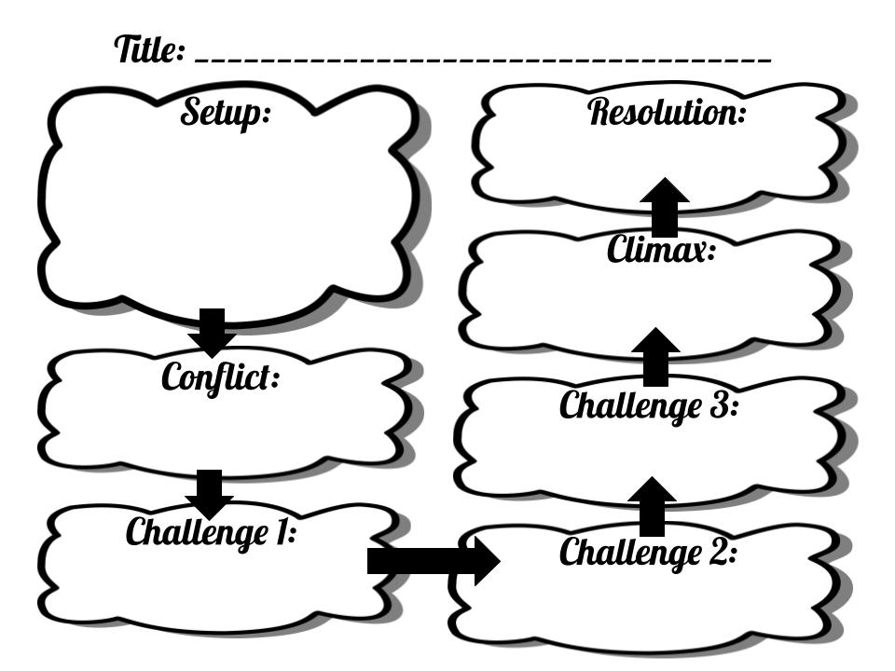
Plan Your Narrative Story in Teams
Notes:
Make copies and adapt this original document

Slide 13
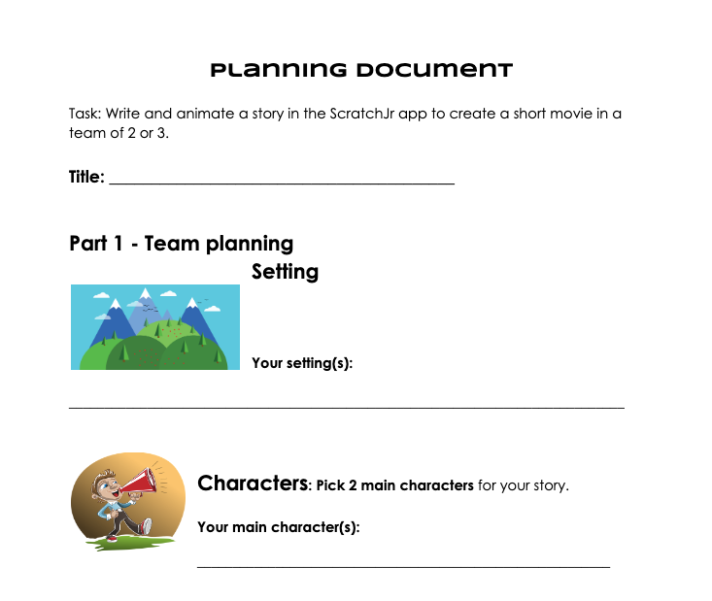
Writing Time!
Part 1 - In teams
Part 2 - Individually
Part 3 - Revise and edit
Document
Notes:
Adapt it to Scratch and Scratch Jr.

Slide 14
Time to Animate Your Story
Scratch Jr
Notes:
Toontastic 3D is not available on iPads if it’s not already uploaded. Available on Android tablets.
Other animation tools: Powtoon

Slide 15

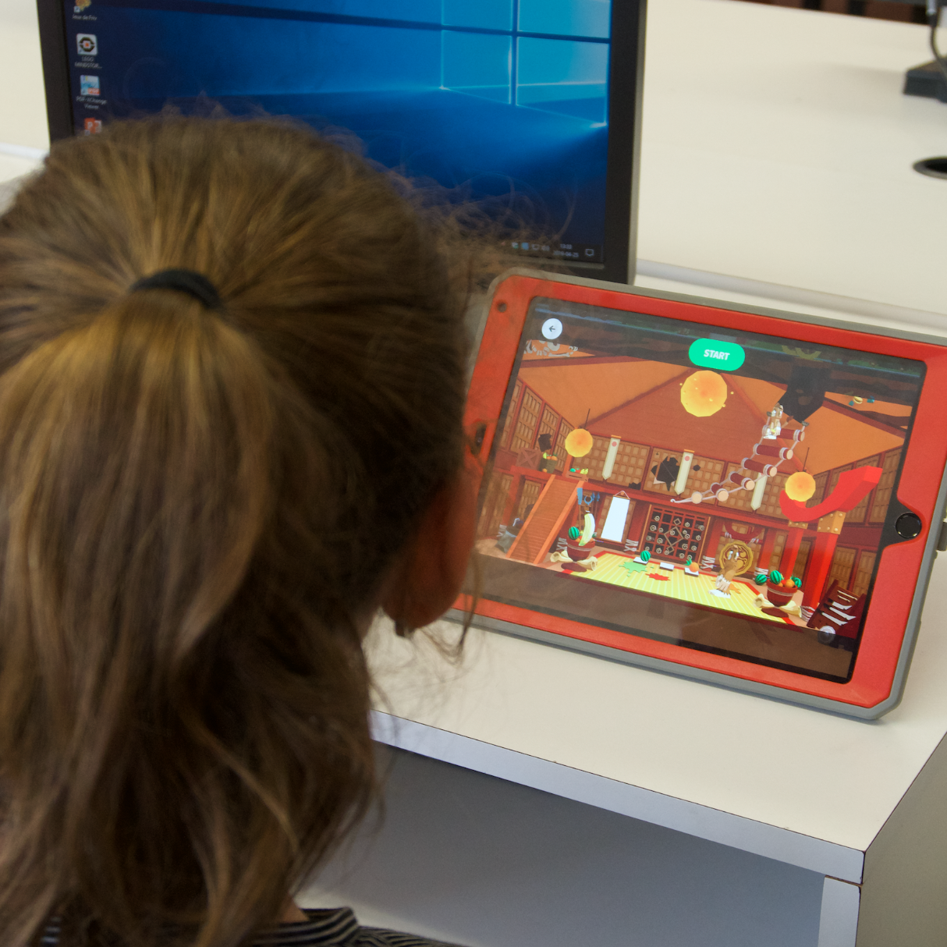
Share Your Story
Once Upon a Time...
Notes:
Write the tool you wish to use to share the final products. Suggestions: Google Site, Sway, Wakelet, Padlet, Digipad or on the Scratch platform for Scratch projects.
Share Ozobot maps if they were done.

Slide 16
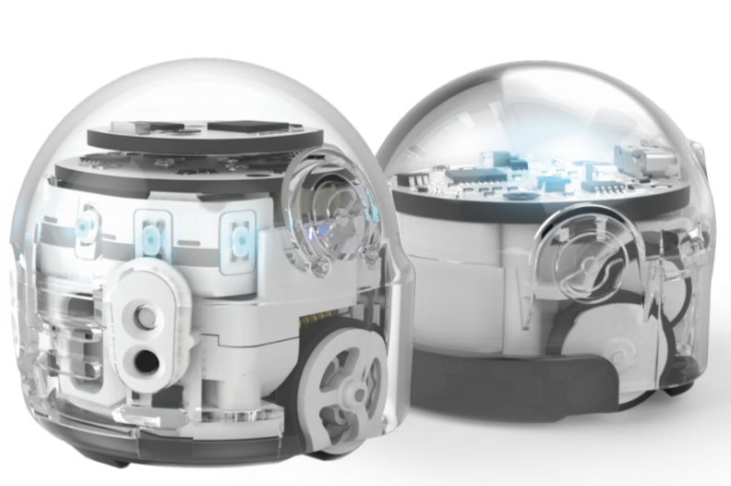
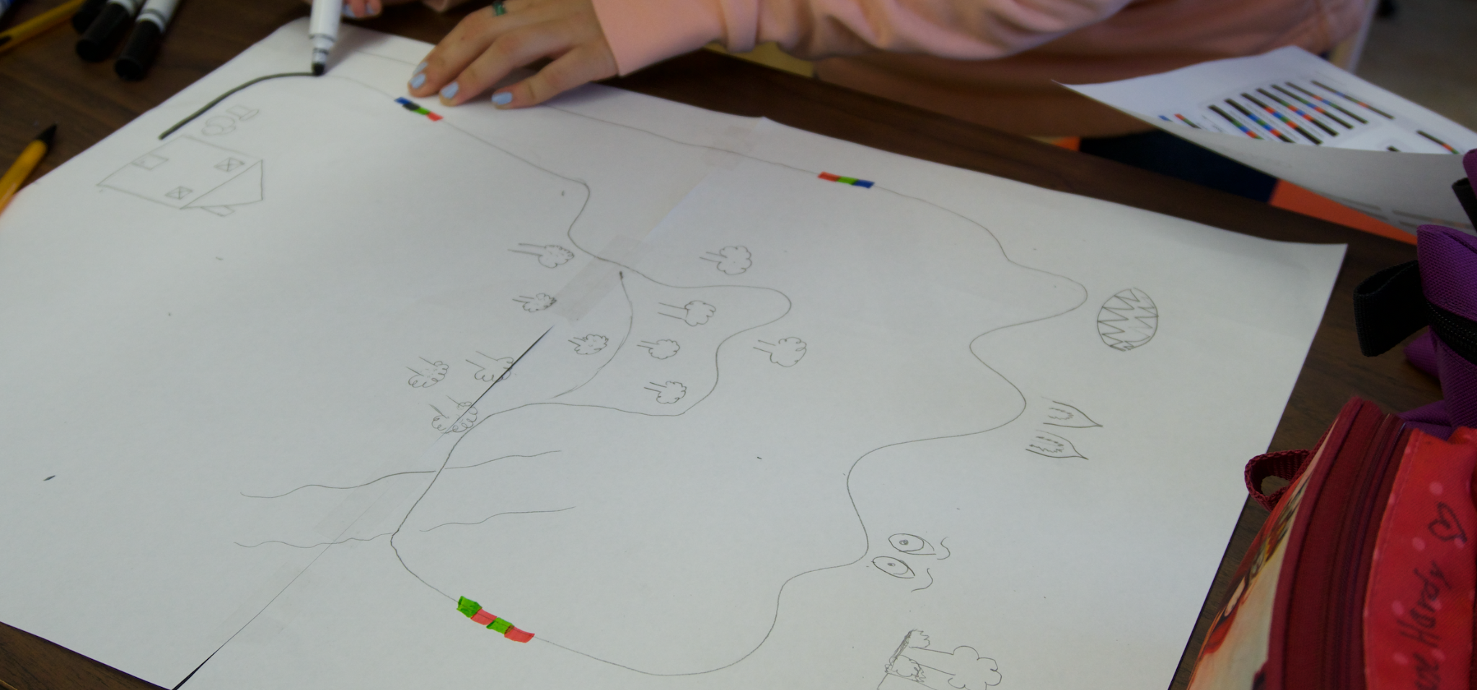
Optional Activity
Ozoblockly
Create programs for Ozobots.
Story map model
Animate important elements of a story example.
The Little Red Riding Hood Story
Animate this story on your map.

Slide 17
Thanks!
Do you have any questions?
youremail@freepik.com
+91 620 421 838
yourcompany.com
Please keep this slide for attribution

