Slide 1
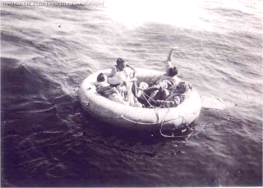
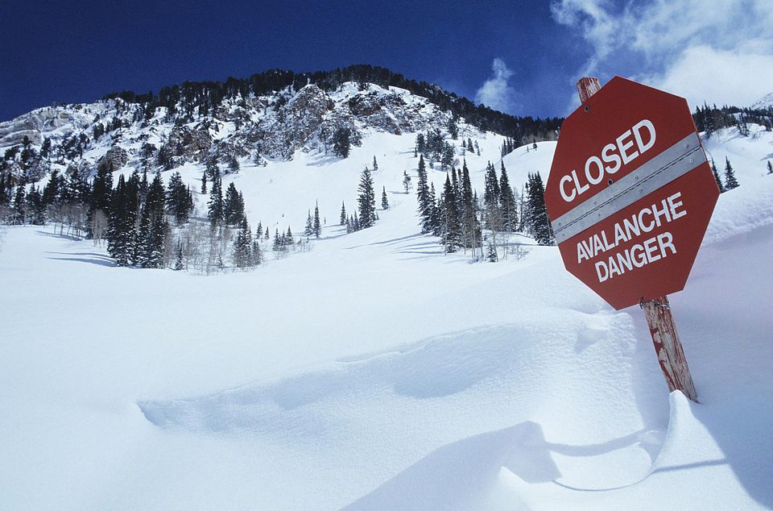
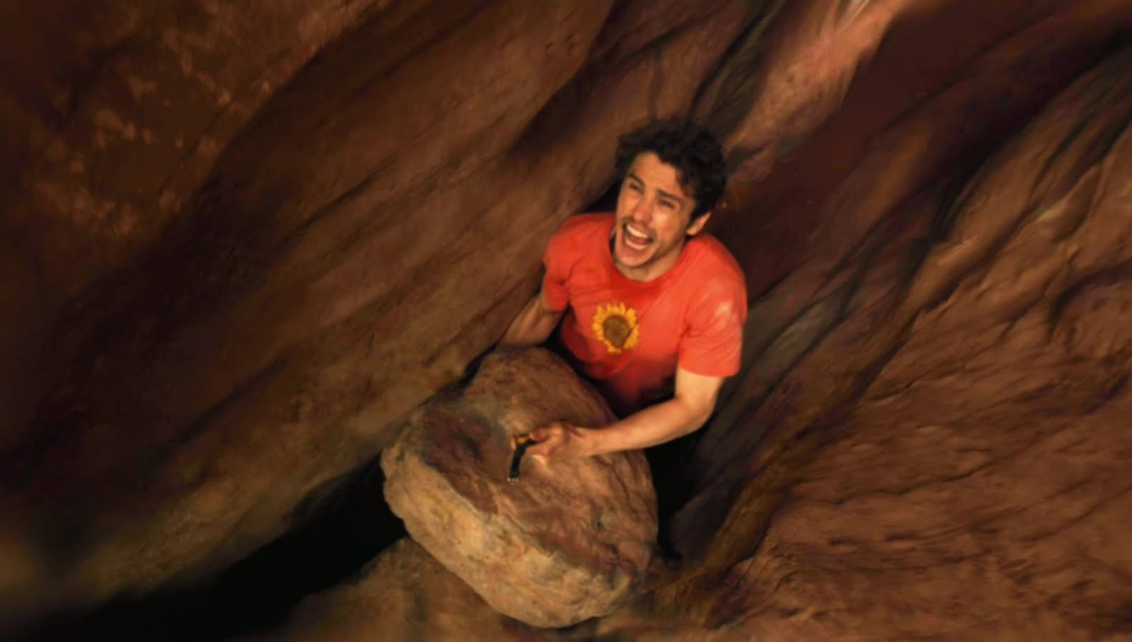
A Survivor’s Journal
Write and record a survival story using Video Response
Name:
Group: Date:
Anne-Marie Morin, ESL Teacher, CS de la Beauce-Etchemin in collaboration with Dianne Stankiewicz, ESL Consultant CSBE and Sandra Laine and Alexandra Coutlée, Pedagogical Consultants, Service national du RÉCIT, domaine des langues

Slide 2
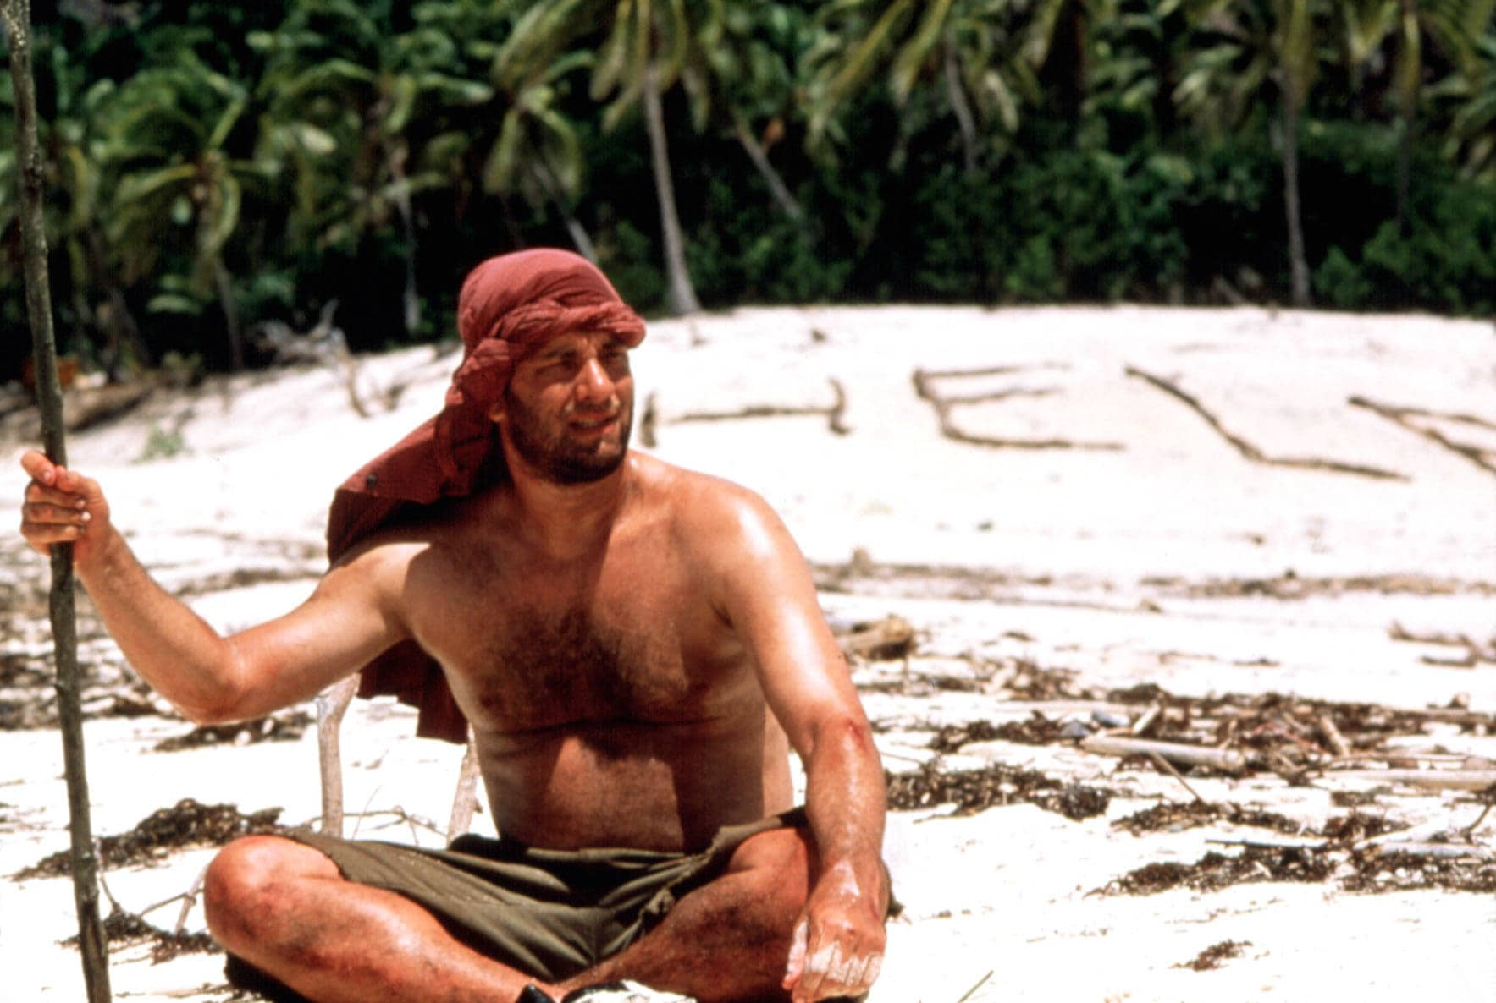
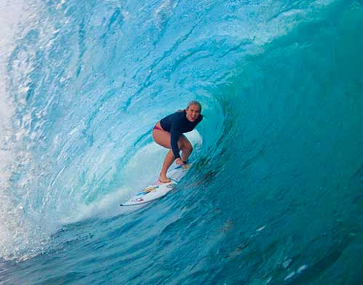
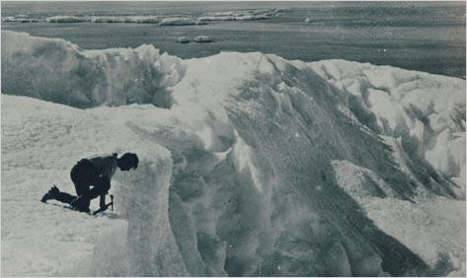
Create a copy if you want to modify to this document.
Name: __________________________________
A Survivor’s Journal
Have you ever thought about how you would react or what would you do if you found yourself in a survival situation? How would you feel to be stranded somewhere? Would your survival instincts kick in? In this unit, you will have the opportunity to explore various authentic survival stories and to witness true courage and perseverance as you learn about some strong-willed individuals who overcame the elements.
With one or two partners, you will decide on a hypothetical survival situation and you will write a journal or diary as if you were stranded somewhere and had to survive. The sequence of events, the problems encountered and the solutions used during your adventure are yours to decide. Be as realistic as possible!!
You will be using a tool called Flipgrid in order to record a video that will relate events, emotions and feelings you underwent. You will have to describe your story and make it as authentic as possible. Your video will be presented to your classmates and used for a special in-class activity.
As you work with your teammates (teams of two or three),
make sure you use your checklist to meet all of the
requirements and keep in mind the rubrics your
teacher will use to evaluate both your
speaking and writing skills.

Slide 3
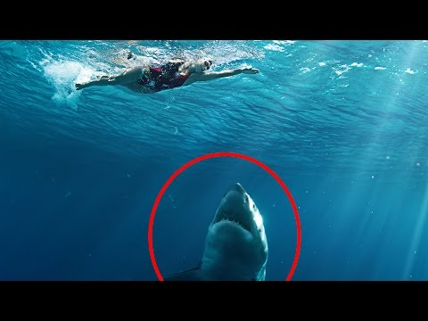
Activity 1: Amazing Survival Stories
Part A: Watch this video clip of 10 amazing survival stories. As you watch, complete the chart below by summarizing what the amazing survivor had to survive. The first one is done for you.
https://youtu.be/kXa-ztFZY9I
Name of survivor(s) | What did they survive?
10-Eric Lemarque | Lost while snowboarding, fell in water
9-Bethany Hamilton
8-Justin and Jeremy Harris
7-Tami Ashcraft
6-Yossi Ghinsberg
5-Ricky Megee
4-Steven Callahan
3-Aron Ralston
2-Joe Simpson and Simon Yates
1-Jan Baalsrud

Slide 4
Part B: Discuss the following questions with two other students.
1-Decide who will be student A, B and C.
2-Student A starts by reading the first question.
3-Continue the discussion until all of the questions have been discussed.
Student A 1-Which of the stories had you heard of before? Explain. 4-Choose one of the stories from the video clip. What would you you have done in that situation? 7-What do you think the people in the video clip learned from their experience? 10-What are your biggest fears? | Student B 2-Do you know anyone who lived an actual survival story? 5-Have you ever been faced with a dangerous or challenging situation? 8-What do you need to do in order to cope with adverse conditions? 11-Do you think you’re a courageous person? Why or why not?
Student C 3-Which survival story from the clip impressed you the most? 6-Have you ever had to save your own life or someone else’s life? 9-Would you leave on a trip by yourself? Why or why not? 12-Of the 10 situations, which one would make the best movie?

Slide 5
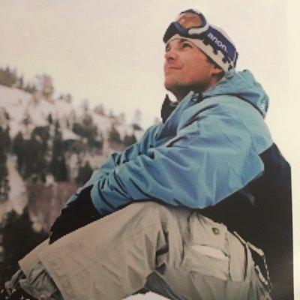
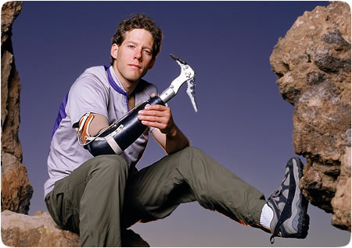
Activity 2: Amazing Survival Stories
Part A:
Decide who will be student A, B, and C in your group.
Read or view the texts and then complete the storyboard for your story.
Text A: Eric LeMarque
Interview with Eric LeMarque
Snowboarder Describes Days on Edge of Survival
Eric LeMarque’s biography
Text B: Aron Ralston
Did Climber Have to Cut Off Arm to Save Life?
Interview with Aron Raslton
Aron Raslton’s Biography
Text C: Bethany Hamilton
Bethany Hamilton’s Story
Bethany Hamilton: Video
Bethany Hamilton’s Biography

Slide 6
Complete Your Amazing Story Storyboard
Who is featured in your Survivor story?
Describe how they ended up in this situation.
What happened? How did they get in this situation?
Where were they? When was this? Describe what was around them, what they saw and felt, the weather, EVERYTHING!

Slide 7
Complete Your Storyboard
What difficulties were they faced with? What did they do? How did they fix these problems (or not…)?
How were they feeling? How did they act throughout this situation?
Describe their feelings and actions.
How did their story end? Did they survive this situation or perish?

Slide 8
Activity 2: Amazing Survival Stories
Part B:
Answer the 5 Check Your Understanding Questions for your text on a separate sheet of paper or in a new document.
Text A
1.What was Eric’s first passion?
2.Why was Eric able to survive for so long?
3.How did Eric’s family find out he was missing?
4.What were the consequences of this adventure for Eric?
5.How does Eric make a difference today in helping prevent similar situations?
Text B
1.What was Aron’s #1 rule that he broke that day?
2.How long was Aron trapped?
3.What did Aron decide, on the very first day, that he was going to have to do ?
4.What is the name of the movie that was made about Aron’s adventure?
5.What job did Aaron have before he decided to quit and pursue a career in mountain climbing?
Text C
1.What does Bethany remember about the event?
2. When did the incident occur?
3. How old was Bethany when she began surfing?
4.How long did it take Bethany to start surfing again?
5. What are the names of the two movies made about Bethany?

Slide 9
Activity 3: Share Your Stories
1-Take turns presenting the stories you read about. Use the storyboard and the Check Your Understanding questions you completed to help you report to your group.
2-Choose one of the three stories. As a team, list the problems this person faced and discuss what this person should have done. Write down your answers below.
Problems | He should have .../ She should have...
1.
2.
3.
4.
5.

Slide 10
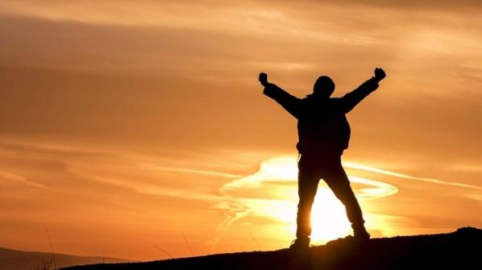
Final Task: A Survivor’s Journal
Throughout this unit, you have had the opportunity to read and learn about different survival and adventure stories. You have learned about how some people can find ways to make it through the most dangerous situations.
Now is your chance to surprise me with a survival story of your own!
YOUR PROJECT:
Imagine you have survived a very difficult and dangerous ordeal. While trying to survive, you were able to write a series of entries about what was happening to you. You wrote about your actions, your thoughts and some of the events and problems you were faced with.
I want you to CREATE this journal. Then, you will have to record your entries using the application chosen by your teacher. You will use one device per team.
Who are you? With whom are you?
Describe how you ended up in this situation.
What happened? How did you get to where you are now?
Where are you? When is this? Describe what’s around you, what you see, what you feel, the weather, EVERYTHING!
What are the difficulties you think you’ll be faced with? What are you going to do? How are you going to fix these problems (or not…)?
How are you feeling? How are you going to act throughout this situation?
Describe each person’s feelings and actions.
How is this going to end? Are you going to survive to this situation or perish?

Slide 11
Complete Your Storyboard
Who are you? With whom are you?
Describe how you ended up in this situation.
What happened? How did you get to where you are now?
Where are you? When is this? Describe what’s around you, what you see, what you feel, the weather, EVERYTHING!

Slide 12
Complete Your Storyboard
What are the difficulties you think you’ll be faced with? What are you going to do? How are you going to fix these problems (or not…)?
How are you feeling? How are you going to act throughout this situation?
Describe each person’s feelings and actions.
How is this going to end? Are you going to survive to this situation or perish?

