Slide 1

WACKY NEWS REPORT
LES - ENGLISH AS A SECOND LANGUAGE
ESL - Elementary, Cycle 3
TEACHER GUIDANCE PRESENTATION
Nadia Laurendeau and Sandra Laine
Service national du RÉCIT, domaine des langues
Updated, October 2026

Slide 2
LES - Goal
Reinvest information learned about meteorological phenomena to produce a wacky weather news report using an avatar type of application.

Slide 3

Do you know this story?
Brainstorm vocabulary from the book.

Slide 4

Review the story
Answer the following questions
Access the quiz

Slide 5
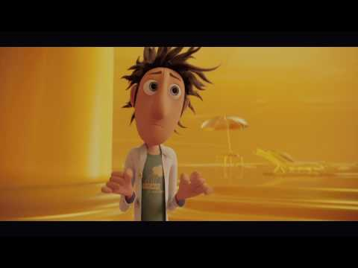

Let’s watch the movie trailer

Slide 6

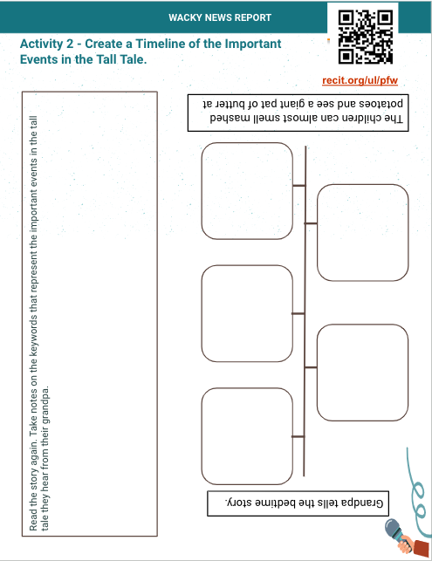
Create a timeline of important events
Timeline RWT
Online Tool

Slide 7
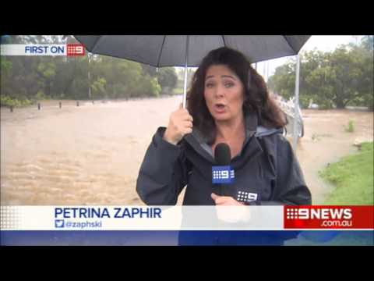
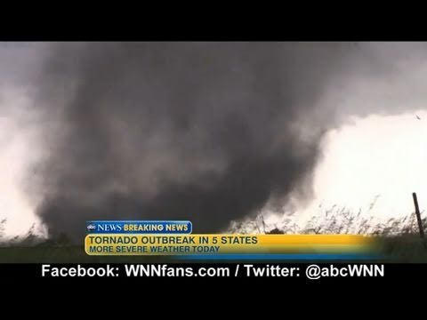
What is a weather report?

Slide 8

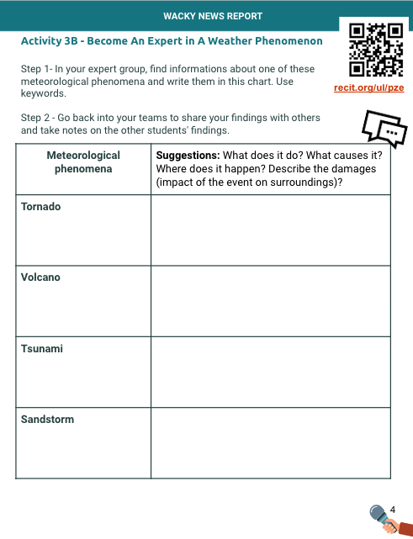
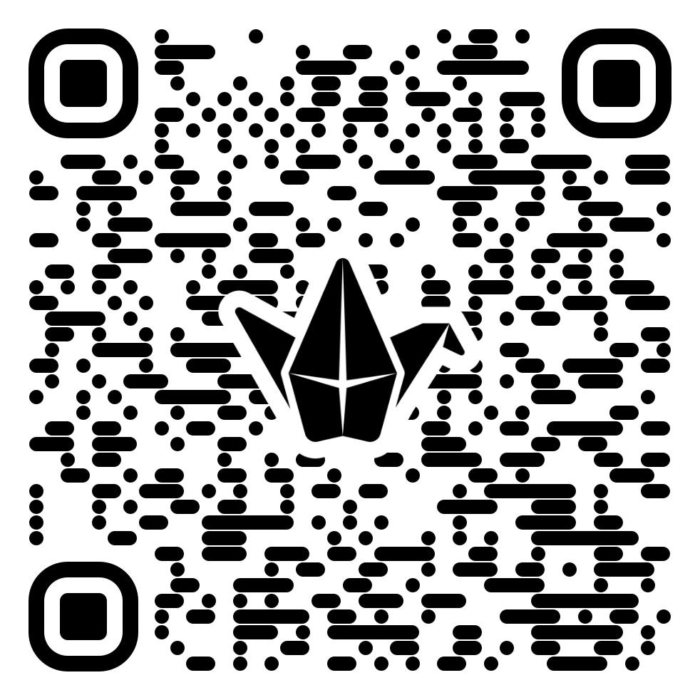

Become an expert
Finding Information
You will become an expert of a weather phenomenon: tornado, volcano, sandstorm or tsunami.
Access

Slide 9
Activity 3c) - Share your expertise
Sharing Information
One student from each team becomes an expert and explains the findings from their research.
Access

Slide 10


Activity 4 - Review Vocabulary About Weather Phenomena
Review the vocabulary and discuss the possible answers with a partner.
I think this is……..
I agree/I disagree
I also think this is a ………..
Access flashcards

Slide 11
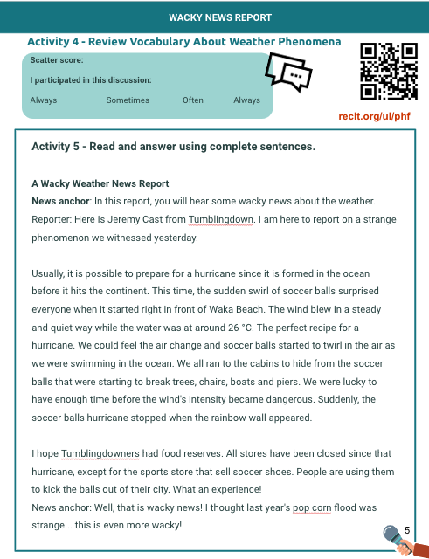
Demonstration of understanding
Read and answer questions about a text.

Slide 12
Review
Kahoot
Review the different natural phenomena that you discovered in your reading and sharing activity.
Link to the quiz

Slide 13
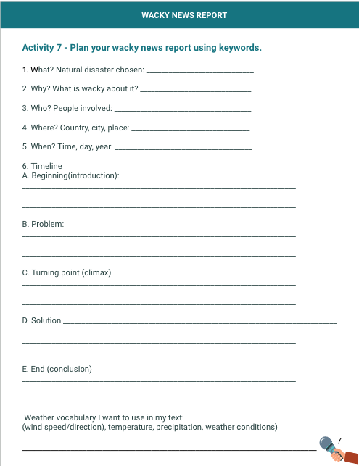
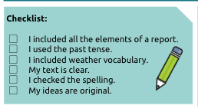
Plan and Write
Choose a weather phenomenon that you would like to use in your wacky news report.

Slide 14


Produce
Prepare a digital version of a wacky weather news report using one of the suggested apps.
Online
iOS
Android
iOS

Slide 15
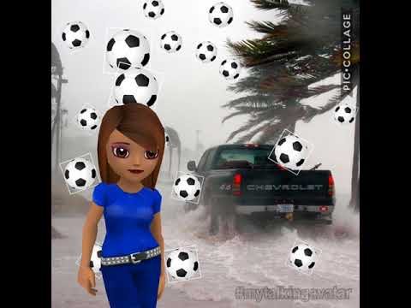
An example of a final production

Slide 16
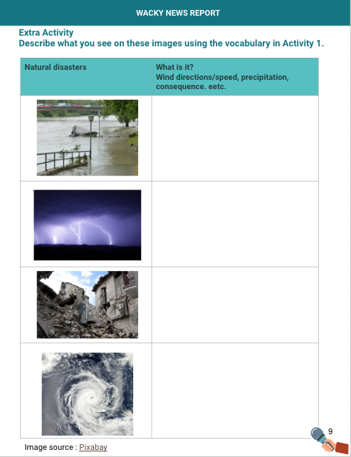
EXTRA ACTIVITY

Slide 17
THANKS!
Do you have any questions?
youremail@freepik.com
+91 620 421 838
yourcompany.com
Please keep this slide for attribution

Slide 18

Follow Us...
Site: www.domainelangues.qc.ca
Twitter: @domainelangues
Facebook: www.facebook.com/domainelangues
sandra.laine@recit.qc.ca
facebook.com/domainelangues
nadia.laurendeau@recit.qc.ca

