Slide 1

Special Christmas activity
Service national du RÉCIT, domaine des langues
Cycle 2

Slide 2
Note for teachers
Modify this document according to your lesson.

Slide 3




Functional language - videoconference

Slide 4



Functional language - Activity
HRISTMA

Slide 5




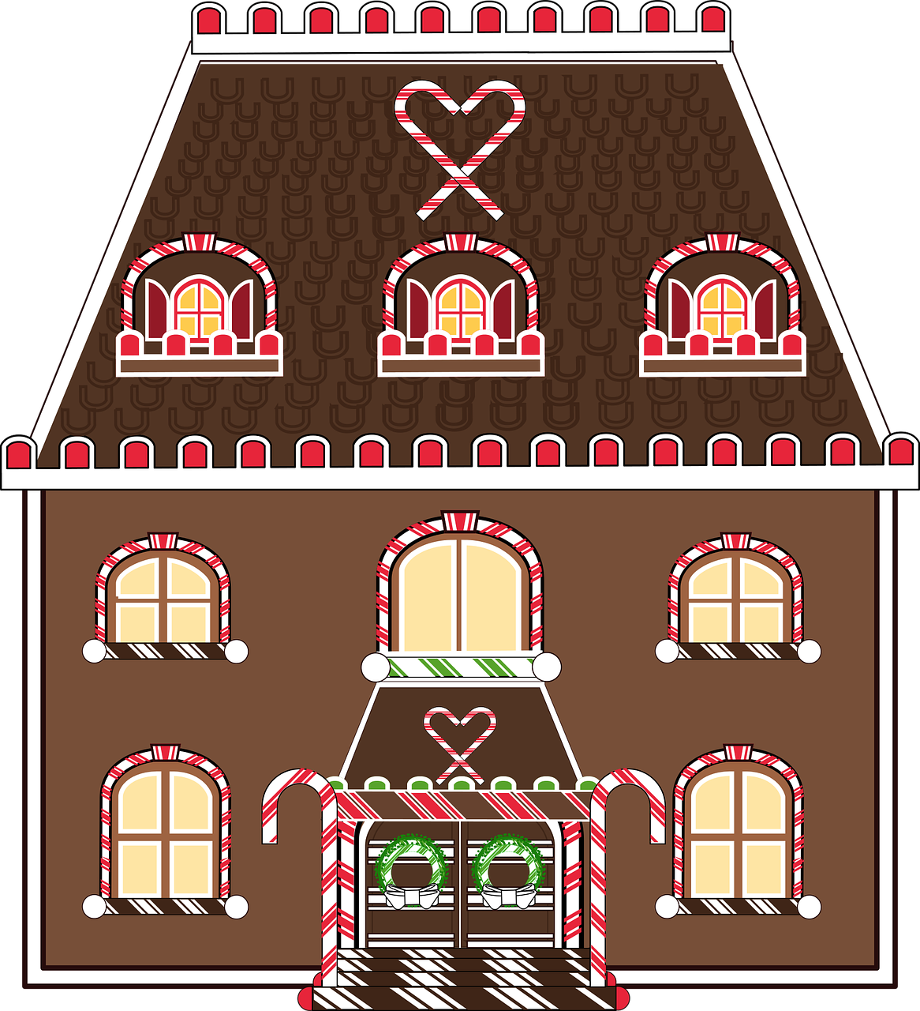
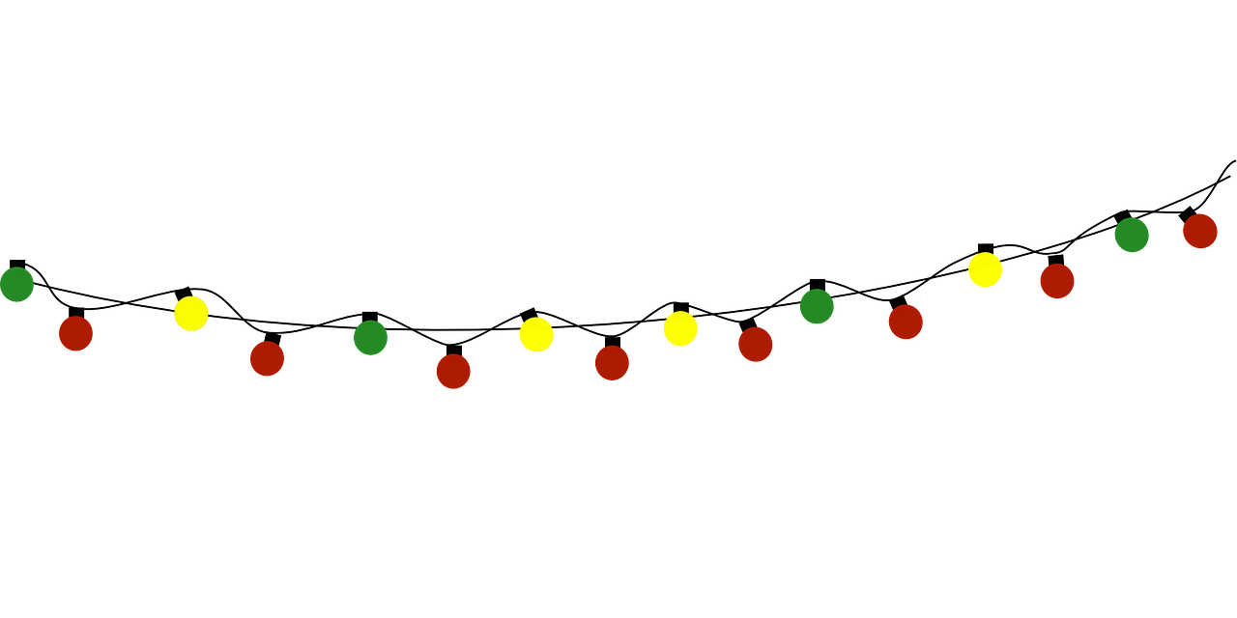
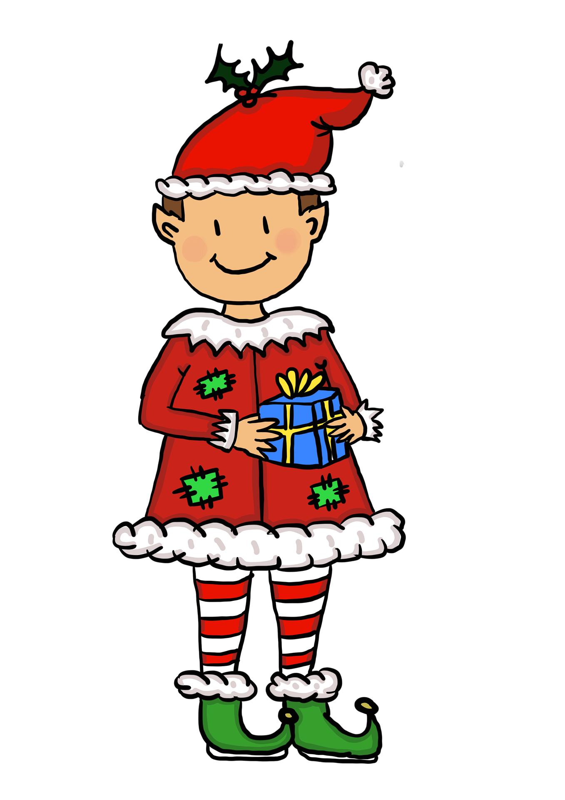





THE CLUMSY LITTLE EFL VOCABULARY
bells
Christmas lights
candy cane
powdered sugar
gingerbread house
elf
Christmas tree
stocking
purple gift
blue gift
yellow gift

Slide 6
Do you have an elf In your house?

Slide 7


The clumsy little elf - the story
Click here

Slide 8
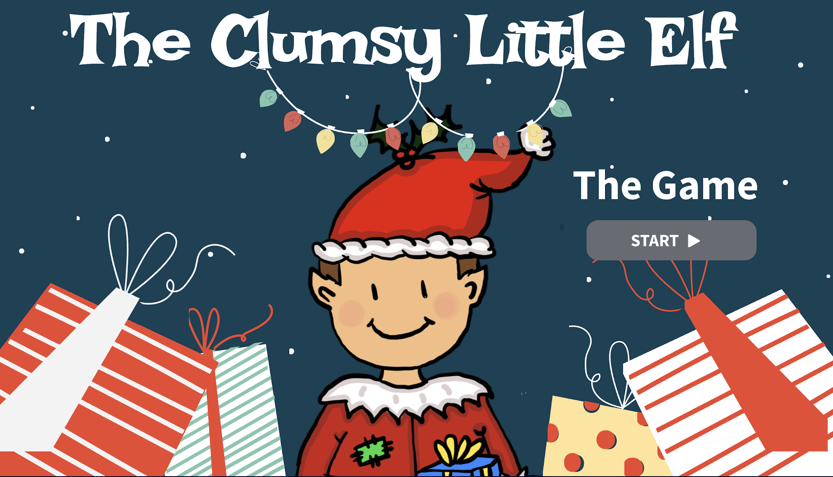
The clumsy little elf - the game
Click here

Slide 9

Draw Klutz doing a trick

Slide 10
Merry christmas and happy holidays

Slide 11
THANKS!
Service national du RÉCIT, domaine des langues
Please keep this slide for attribution.

