Slide 1
Holiday Traditions Around the World
Secondary
Service national du RÉCIT, domaine des langues

Slide 2
Modify this presentation according to your lesson.

Slide 3
Traditions
What is a tradition?
Do you have traditions in your family?

Slide 4
Your Mission - Secondary 1 and 2

Slide 5
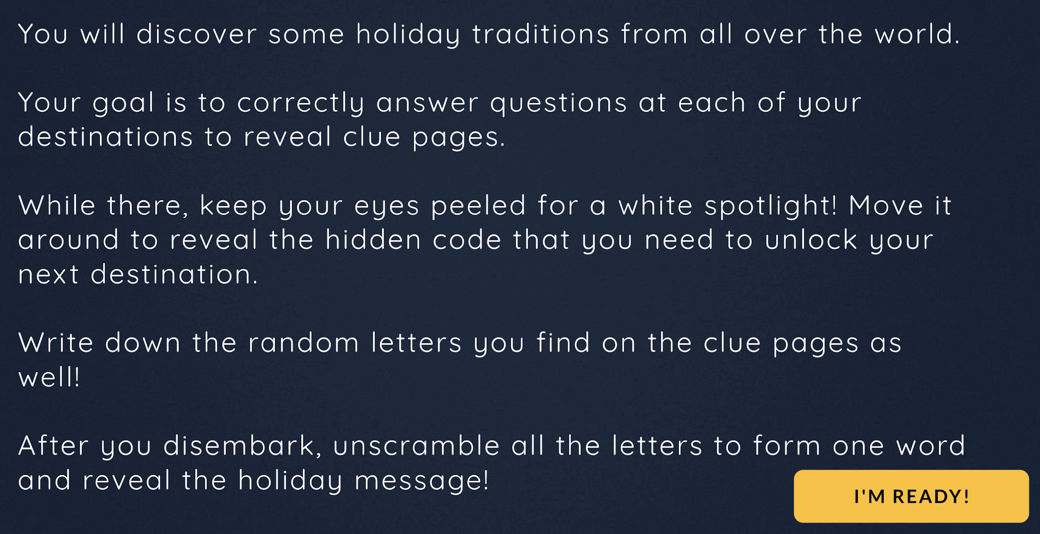
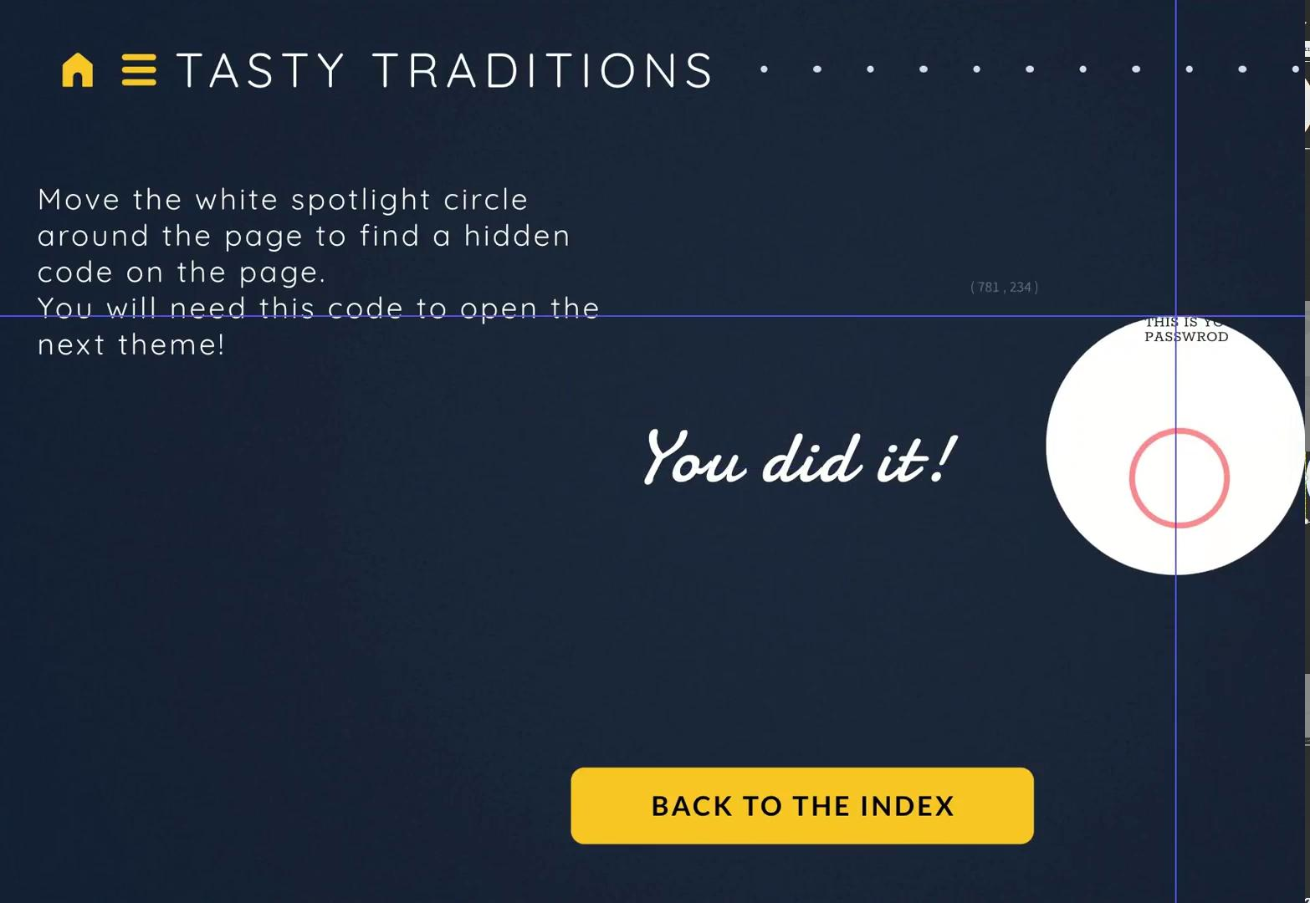
Your Mission - Secondary 3, 4 and 5

Slide 6
Class Organization
Edit this slide with your information
Add information about your class organization:
How will you provide the link to the game?
Will you create breakout rooms for students? How many students per team?
How much time are you giving students to play the game?

Slide 7
The Game
Secondary 1 and 2
Click here to access game

Slide 8
The Game
Secondary 3,4 and 5
Click here to access game

Slide 9
Possible oral interaction
Keep this slide if you want to have an oral interaction activity. Select or write your questions.
How are traditions created?
What is needed to keep a tradition alive?
Agree on which tradition you would like to have in your town.
Explain which tradition you would like to try at home.
Your school pays for your trip if you can all agree on where to go celebrate a tradition. Agree on where to go and why.
Categorize the different traditions that were presented.

Slide 10
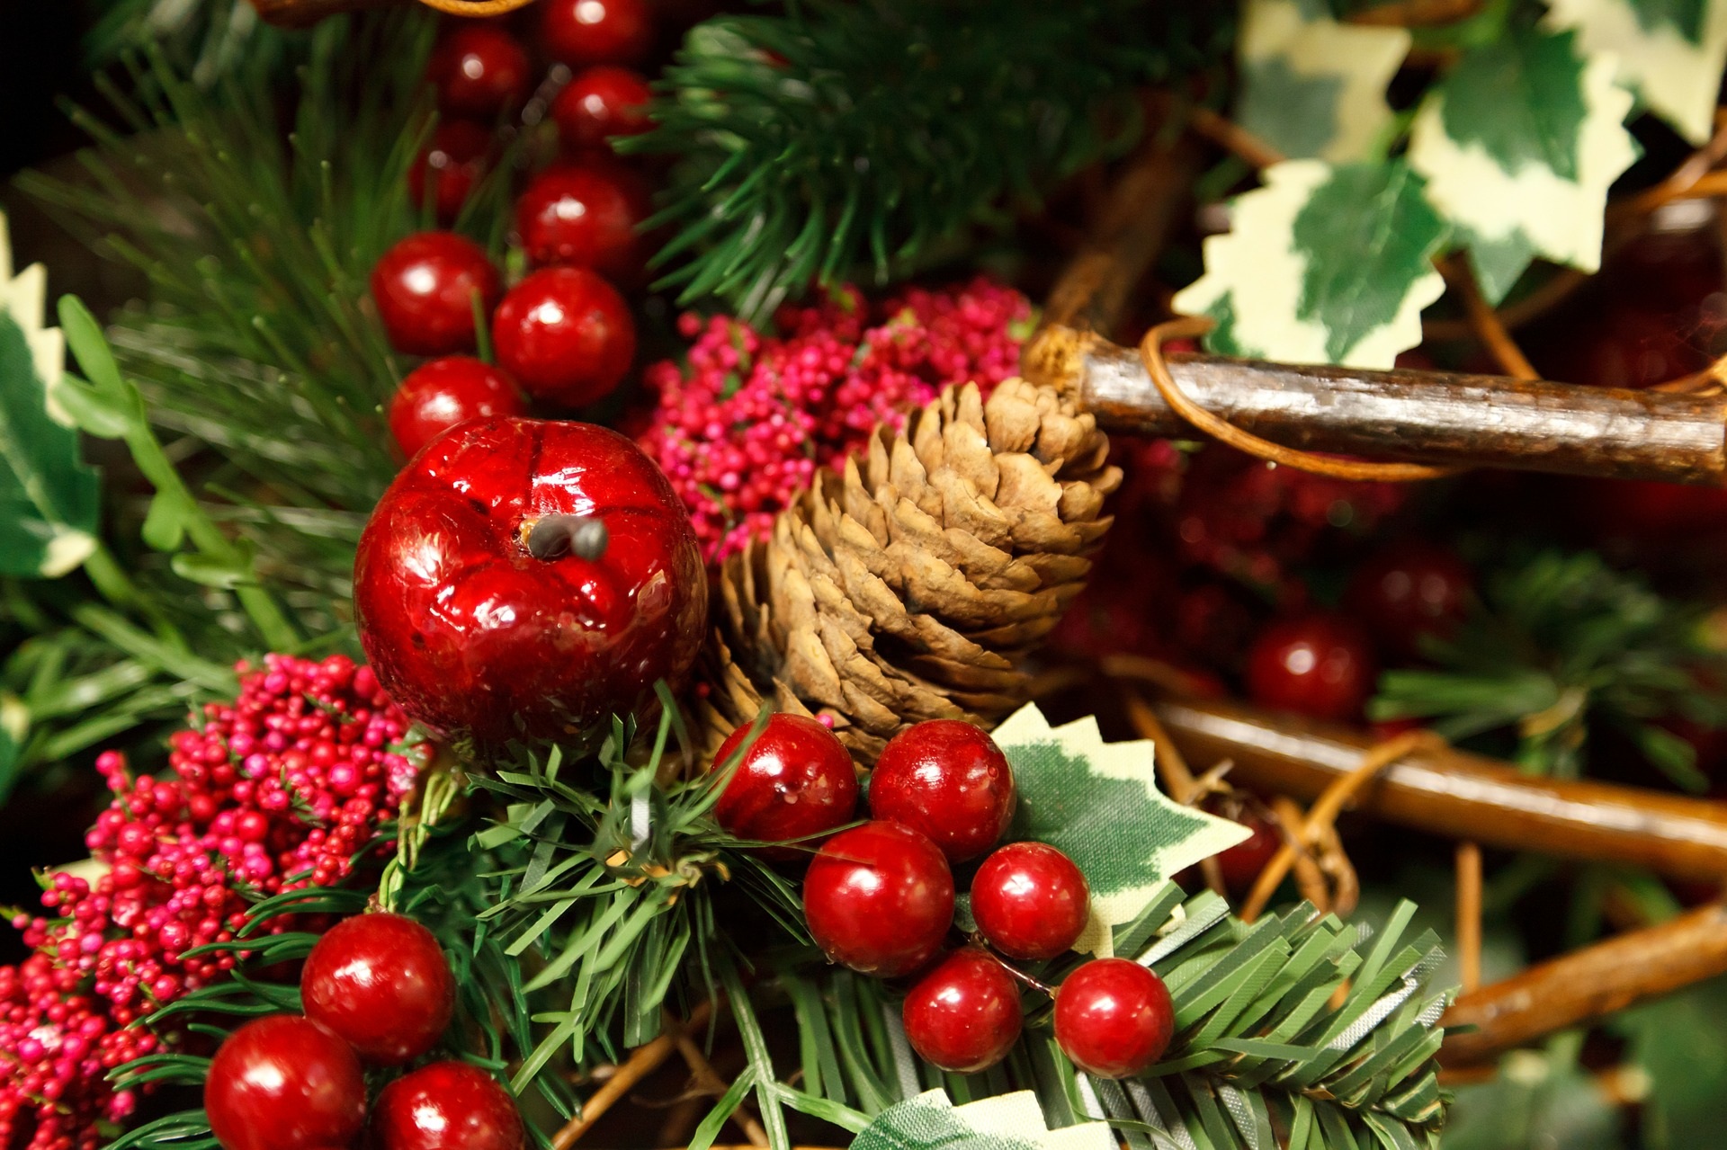
Possible writing and text production
Keep this slide if you want to have Select or write your questions.
Possible Prompts:
Get inspired with the questions seen above for C1.
Describe a particular family tradition.
Recall a memory that took place during a tradition.
Imagine the origin story of a spooky tradition.
Write a message to thank someone who is making this holiday better for others.

Slide 11
Merry Christmas and Happy Holidays

Slide 12
Thanks!
Service national du RÉCIT, domaine des langues
www.domainelangues.qc.ca/en
Please keep this slide for attribution.

